Slide 1
Retrieval Practice
Doubles (to double 5)

Slide 2
Teacher Notes
This set of slides include a selection of tasks which allow the children to re-visit the doubles for the numbers 1 to 5, and provide an opportunity for you to assess their recall.
In the classroom you could also:
Use ‘call and response’ during transition times; e.g. ‘10 is made of double…’. Children respond: ‘5. Double 5 is 10.’
Mastering Number 2021/22 ncetm.org.uk

Slide 3

Show the SAME pattern on your fingers and SAY the number you have made.
Mastering Number 2021/22 ncetm.org.uk

Slide 4

2
_____ is made from _____ and _____ ; double _____ is _____.
Mastering Number 2021/22 ncetm.org.uk

Slide 5
4
_____ is made from _____ and _____ ; double _____ is _____.
Mastering Number 2021/22 ncetm.org.uk

Slide 6
6
_____ is made from _____ and _____ ; double _____ is _____.
Mastering Number 2021/22 ncetm.org.uk

Slide 7
8
_____ is made from _____ and _____ ; double _____ is _____.
Mastering Number 2021/22 ncetm.org.uk

Slide 8
10
_____ is made from _____ and _____ ; double _____ is _____.
Mastering Number 2021/22 ncetm.org.uk

Slide 9
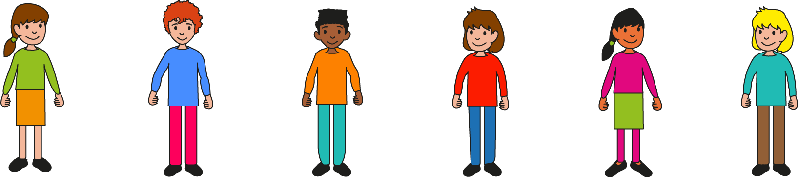
Now say the doubles that you can see on the dice patterns.
Mastering Number 2021/22 ncetm.org.uk

Slide 10
_____ is made from _____ and _____ ; double _____ is _____.
Mastering Number 2021/22 ncetm.org.uk

Slide 11
_____ is made from _____ and _____ ; double _____ is _____.
Mastering Number 2021/22 ncetm.org.uk

Slide 12
_____ is made from _____ and _____ ; double _____ is _____.
Mastering Number 2021/22 ncetm.org.uk

Slide 13
_____ is made from _____ and _____ ; double _____ is _____.
Mastering Number 2021/22 ncetm.org.uk

Slide 14
_____ is made from _____ and _____ ; double _____ is _____.
Mastering Number 2021/22 ncetm.org.uk

Slide 15
Use your doubles knowledge to spot if the same or a different number is shown.
Mastering Number 2021/22 ncetm.org.uk

Slide 16
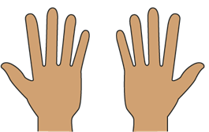
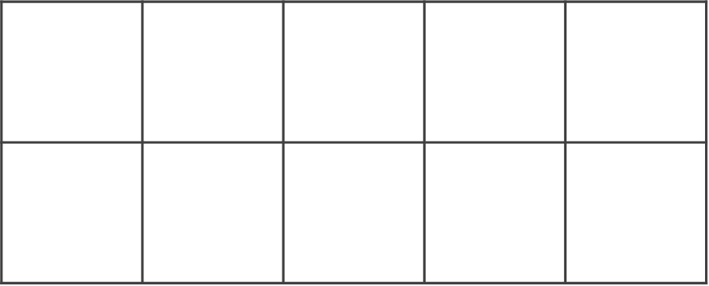
Same or different?
10
8
Mastering Number 2021/22 ncetm.org.uk

Slide 17
Same or different?
8
8
Mastering Number 2021/22 ncetm.org.uk

Slide 18

Same or different?
2
2
Mastering Number 2021/22 ncetm.org.uk

Slide 19
Same or different?
6
8
Mastering Number 2021/22 ncetm.org.uk

Slide 20
Same or different?
8
8
Mastering Number 2021/22 ncetm.org.uk

Slide 21
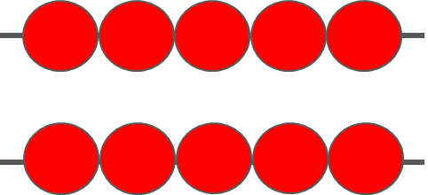
Same or different?
4
10
Mastering Number 2021/22 ncetm.org.uk

Slide 22
Same or different?
4
4
Mastering Number 2021/22 ncetm.org.uk

Slide 23
Same or different?
6
10
Mastering Number 2021/22 ncetm.org.uk

Slide 24
Same or different?
6
6
Mastering Number 2021/22 ncetm.org.uk

Slide 25
Same or different?
8
8
Mastering Number 2021/22 ncetm.org.uk

Slide 26
Can you say the missing whole for these doubles?
Mastering Number 2021/22 ncetm.org.uk

Slide 27
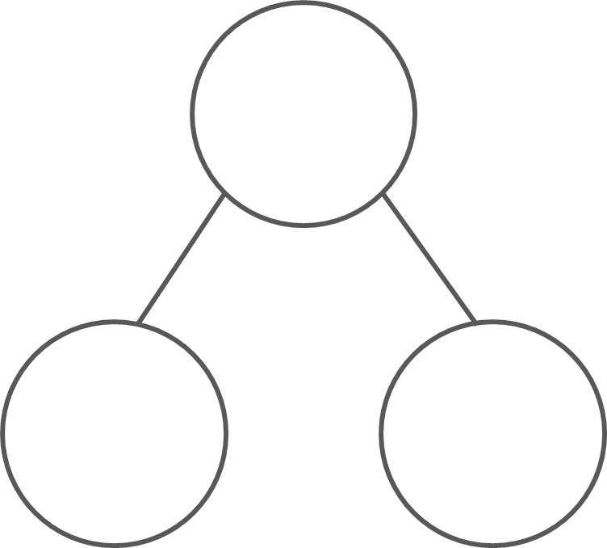
What are the hidden wholes?
2
4
6
8
10
1
1
2
2
3
3
4
4
5
5
_____ is made from _____ and _____ ; double _____ is _____.
Mastering Number 2021/22 ncetm.org.uk

Slide 28
What are the hidden wholes?
6
10
2
8
4
3
3
5
5
1
1
4
4
2
2
_____ is made from _____ and _____ ; double _____ is _____.
Mastering Number 2021/22 ncetm.org.uk

Slide 29
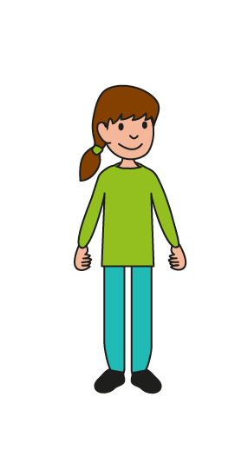
Can you check that my equations are correct?
Mastering Number 2021/22 ncetm.org.uk

Slide 30


2 | + | 2 | = | 4
1 | + | 1 | = | 2
3 | + | 3 | = | 7
5 | + | 5 | = | 10
4 | + | 4 | = | 6
4 | + | 4 | = | 8
2 | + | 2 | = | 4
5 | + | 5 | = | 10
4 | + | 4 | = | 8
1 | + | 1 | = | 3
Mastering Number 2021/22 ncetm.org.uk

Slide 31
Can you say the total/sum for each equation?
Mastering Number 2021/22 ncetm.org.uk

Slide 32
5 | + | 5 | = | 10
Mastering Number 2021/22 ncetm.org.uk

Slide 33
4 | + | 4 | = | 8
Mastering Number 2021/22 ncetm.org.uk

Slide 34
3 | + | 3 | = | 6
Mastering Number 2021/22 ncetm.org.uk

Slide 35
2 | + | 2 | = | 4
Mastering Number 2021/22 ncetm.org.uk

Slide 36
5 | + | 5 | = | 10
Mastering Number 2021/22 ncetm.org.uk

Slide 37
1 | + | 1 | = | 2
Mastering Number 2021/22 ncetm.org.uk

Slide 38
4 | + | 4 | = | 8
Mastering Number 2021/22 ncetm.org.uk

Slide 39
3 | + | 3 | = | 6
Mastering Number 2021/22 ncetm.org.uk

Slide 40
2 | + | 2 | = | 4
Mastering Number 2021/22 ncetm.org.uk

Slide 41
4 | + | 4 | = | 8
Mastering Number 2021/22 ncetm.org.uk

Slide 42
3 | + | 3 | = | 6
Mastering Number 2021/22 ncetm.org.uk

Slide 43
2 | + | 2 | = | 4
Mastering Number 2021/22 ncetm.org.uk

Slide 44
3 | + | 3 | = | 6
Mastering Number 2021/22 ncetm.org.uk

