Slide 1
Mastering Number
Retrieval Practice
Bonds of 9

Slide 2
Teacher Notes
This set of slides includes a selection of tasks for the children to re-visit bonds of 9 and provides an opportunity for you to assess their recall.
In the classroom you could also:
Use ‘call and response’ during transition times: ‘9 is made of 4 and …’ and the children respond with ‘… 5; 4 and 5 make 9.’
Make 9 on one row of the rekenrek then on two rows: start with ‘one push 4, now what do you need to make 9?’
Play ‘how many hiding?’ using 9 cubes and a cloth or bag.
At home:
Use the dot patterns to identify the bonds of 9.
Mastering Number 2021/22 ncetm.org.uk

Slide 3
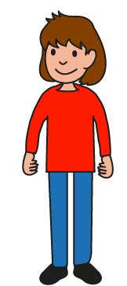
Can you find all the number bonds of 9 in the 9-grid?
Mastering Number 2021/22 ncetm.org.uk

Slide 4
9 is made of _____ and _____ ;
_____ and _____ make 9.
Mastering Number 2021/22 ncetm.org.uk

Slide 5
9 is made of _____ and _____ ;
_____ and _____ make 9.
Mastering Number 2021/22 ncetm.org.uk

Slide 6
9 is made of _____ and _____ ;
_____ and _____ make 9.
Mastering Number 2021/22 ncetm.org.uk

Slide 7
9 is made of _____ and _____ ;
_____ and _____ make 9.
Mastering Number 2021/22 ncetm.org.uk

Slide 8
9 is made of _____ and _____ ;
_____ and _____ make 9.
Mastering Number 2021/22 ncetm.org.uk

Slide 9
9 is made of _____ and _____ ;
_____ and _____ make 9.
Mastering Number 2021/22 ncetm.org.uk

Slide 10
9 is made of _____ and _____ ;
_____ and _____ make 9.
Mastering Number 2021/22 ncetm.org.uk

Slide 11
9 is made of _____ and _____ ;
_____ and _____ make 9.
Mastering Number 2021/22 ncetm.org.uk

Slide 12
Can you see number bonds of 9 in these 9-grids?
Say what you see!

Slide 13
9 is made of ___ and ___;
___ and ___ make 9.
Mastering Number 2021/22 ncetm.org.uk

Slide 14
9 is made of ___ and ___;
___ and ___ make 9.
Mastering Number 2021/22 ncetm.org.uk

Slide 15
9 is made of ___ and ___;
___ and ___ make 9.
Mastering Number 2021/22 ncetm.org.uk

Slide 16
9 is made of ___ and ___;
___ and ___ make 9.
Mastering Number 2021/22 ncetm.org.uk

Slide 17
9 is made of ___ and ___;
___ and ___ make 9.
Mastering Number 2021/22 ncetm.org.uk

Slide 18
9 is made of ___ and ___;
___ and ___ make 9.
Mastering Number 2021/22 ncetm.org.uk

Slide 19
9 is made of ___ and ___;
___ and ___ make 9.
Mastering Number 2021/22 ncetm.org.uk

Slide 20
9 is made of ___ and ___;
___ and ___ make 9.
Mastering Number 2021/22 ncetm.org.uk

Slide 21
9 is made of ___ and ___;
___ and ___ make 9.
Mastering Number 2021/22 ncetm.org.uk

Slide 22
9 is made of ___ and ___;
___ and ___ make 9.
Mastering Number 2021/22 ncetm.org.uk

Slide 23
9 is made of ___ and ___;
___ and ___ make 9.
Mastering Number 2021/22 ncetm.org.uk

Slide 24
9 is made of ___ and ___;
___ and ___ make 9.
Mastering Number 2021/22 ncetm.org.uk

Slide 25
9 is made of ___ and ___;
___ and ___ make 9.
Mastering Number 2021/22 ncetm.org.uk

Slide 26
9 is made of ___ and ___;
___ and ___ make 9.
Mastering Number 2021/22 ncetm.org.uk

Slide 27
9 is made of ___ and ___;
___ and ___ make 9.
Mastering Number 2021/22 ncetm.org.uk

Slide 28
9 is made of ___ and ___;
___ and ___ make 9.
Mastering Number 2021/22 ncetm.org.uk

Slide 29
9 is made of ___ and ___;
___ and ___ make 9.
Mastering Number 2021/22 ncetm.org.uk

Slide 30
9 is made of ___ and ___;
___ and ___ make 9.
Mastering Number 2021/22 ncetm.org.uk

Slide 31
Play ‘9 or NOT 9?’ with these dotty patterns!
Mastering Number 2021/22 ncetm.org.uk

Slide 32

9 or NOT 9?
Mastering Number 2021/22 ncetm.org.uk

Slide 33

9 or NOT 9?
Mastering Number 2021/22 ncetm.org.uk

Slide 34
9 or NOT 9?
Mastering Number 2021/22 ncetm.org.uk

Slide 35
9 or NOT 9?
Mastering Number 2021/22 ncetm.org.uk

Slide 36
9 or NOT 9?
Mastering Number 2021/22 ncetm.org.uk

Slide 37
9 or NOT 9?
Mastering Number 2021/22 ncetm.org.uk

Slide 38
9 or NOT 9?
Mastering Number 2021/22 ncetm.org.uk

Slide 39
9 or NOT 9?
Mastering Number 2021/22 ncetm.org.uk

Slide 40
9 or NOT 9?
Mastering Number 2021/22 ncetm.org.uk

Slide 41
9 or NOT 9?
Mastering Number 2021/22 ncetm.org.uk

Slide 42
Use your fingers to help you find and show what number is needed to make 9.
Can you say how many dots are missing?
Mastering Number 2021/22 ncetm.org.uk

Slide 43
___ needs ___ to make 9.
9 is made of ___ and ___.
Mastering Number 2021/22 ncetm.org.uk

Slide 44
___ needs ___ to make 9.
9 is made of ___ and ___.
Mastering Number 2021/22 ncetm.org.uk

Slide 45
___ needs ___ to make 9.
9 is made of ___ and ___.
Mastering Number 2021/22 ncetm.org.uk

Slide 46
___ needs ___ to make 9.
9 is made of ___ and ___.
Mastering Number 2021/22 ncetm.org.uk

Slide 47
___ needs ___ to make 9.
9 is made of ___ and ___.
Mastering Number 2021/22 ncetm.org.uk

Slide 48
___ needs ___ to make 9.
9 is made of ___ and ___.
Mastering Number 2021/22 ncetm.org.uk

Slide 49
___ needs ___ to make 9.
9 is made of ___ and ___.
Mastering Number 2021/22 ncetm.org.uk

Slide 50
___ needs ___ to make 9.
9 is made of ___ and ___.
Mastering Number 2021/22 ncetm.org.uk

Slide 51
Can you say the missing part of 9?
Mastering Number 2021/22 ncetm.org.uk

Slide 52
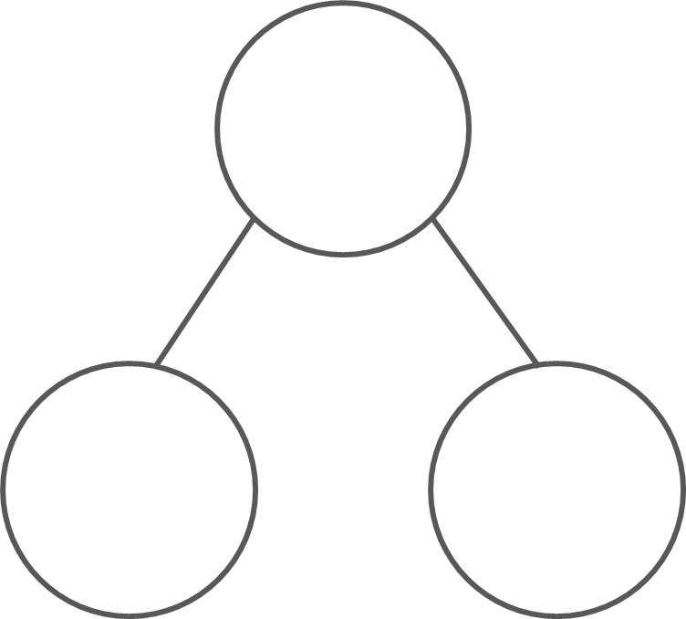
What are the hidden parts?
9
9
9
9
5
4
2
7
1
8
3
6
9 is made of ___ and ___;
___ and ___ make 9.
Mastering Number 2021/22 ncetm.org.uk

Slide 53
What are the hidden parts?
9
9
9
9
7
2
8
1
5
4
6
3
9 is made of ___ and ___;
___ and ___ make 9.
Mastering Number 2021/22 ncetm.org.uk

Slide 54
Practice task
Fill in the missing symbols
=
<
>
4 | + | 4 |  | 9
4 | + | 5 |  | 9
9 | + | 0 |  | 9
3 | + | 7 |  | 9
9 |  | 7 | + | 2
9 |  | 3 | + | 4
9 |  | 3 | + | 6
9 |  | 5 | + | 3
<
=
=
<
=
=
<
>
Mastering Number 2021/22 ncetm.org.uk

Slide 55
Practice task
Fill in the missing symbols
=
<
>
5 | + | 5 |  | 9
9 |  | 2 | + | 7
9 |  | 3 | + | 6
6 | + | 5 |  | 9
9 |  | 0 | + | 9
9 |  | 10 | + | 0
4 | + | 5 |  | 9
1 | + | 8 |  | 9
>
=
=
<
=
=
>
=
Mastering Number 2021/22 ncetm.org.uk

Slide 56
Complete the missing number calculations.
9 | - | 2 | =
9 | - | 9 | =
9 | - | 4 | =
7
0
5
6 | + |  | = | 9
4 | + |  | = | 9
2 | + |  | = | 9
3
5
7
9 | - | 8 | =
0 | + |  | = | 9
1 | + |  | = | 9
1
9
8
Mastering Number 2021/22 ncetm.org.uk

Slide 57
Complete the missing number calculations.
9 | - | 3 | =
9 | - | 7 | =
9 | - | 5 | =
6
2
4
3 | + |  | = | 9
1 | + |  | = | 9
2 | + |  | = | 9
6
8
7
9 | - | 6 | =
2 | + |  | = | 9
4 | + |  | = | 9
3
7
5
Mastering Number 2021/22 ncetm.org.uk

Slide 58
Mastering Number 2021/22 ncetm.org.uk

