Slide 1
Mastering Number
Retrieval Practice
Bonds of 8

Slide 2
Teacher Notes
This set of slides includes a selection of tasks for the children to re-visit bonds of 8 and provides an opportunity for you to assess their recall.
In the classroom you could also:
Use ‘call and response’ during transition times: ‘8 is made of 3 and …’ and the children respond with ‘… 5; 3 and 5 make 8.’
Make 5 on one row then two rows of the rekenrek: start with ‘one push 5, now what do you need to make 8?’
Play ‘how many hiding?’ using 8 cubes and a cloth or bag.
At home:
Use the dot patterns to identify the bonds of 8.
Play ‘how many hiding?’ using any 8 objects and a cloth to hide some of the objects.
Mastering Number 2021/22 ncetm.org.uk

Slide 3
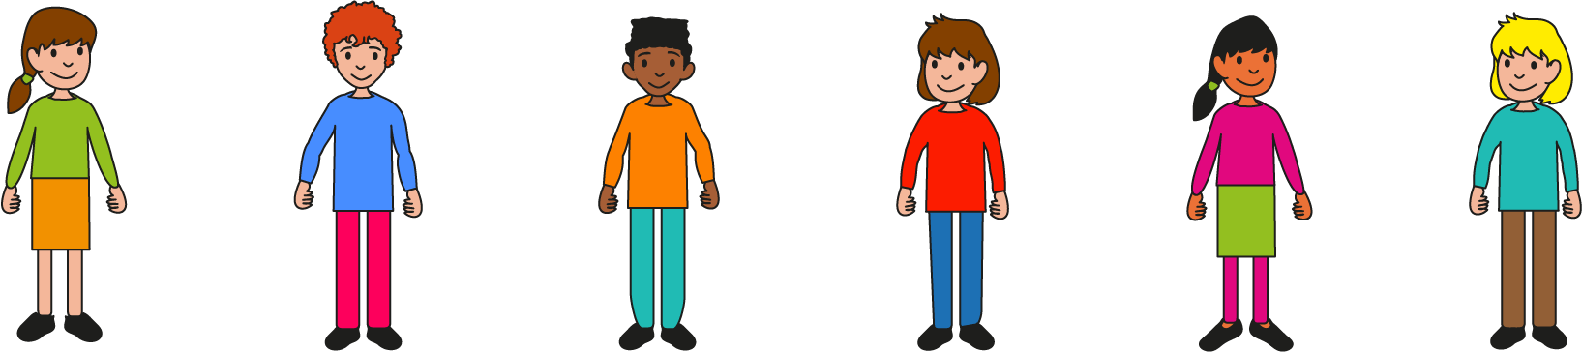
Can you find all the number bonds of 8 in the 8-grids?
Mastering Number 2021/22 ncetm.org.uk

Slide 4
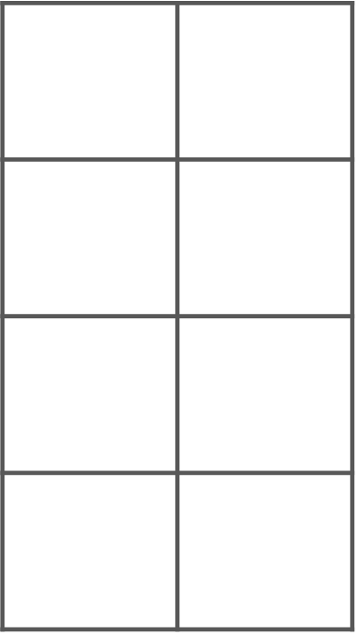
8 is made of _____ and _____ ;
_____ and _____ make 8.
Mastering Number 2021/22 ncetm.org.uk

Slide 5
Can you see number bonds of 8 in these 8-grids?
Say what you see!
Mastering Number 2021/22 ncetm.org.uk

Slide 6
8 is made of ___ and ___;
___ and ___ make 8.
Mastering Number 2021/22 ncetm.org.uk

Slide 7
8 is made of ___ and ___;
___ and ___ make 8.
Mastering Number 2021/22 ncetm.org.uk

Slide 8
8 is made of ___ and ___;
___ and ___ make 8.
Mastering Number 2021/22 ncetm.org.uk

Slide 9
8 is made of ___ and ___;
___ and ___ make 8.
Mastering Number 2021/22 ncetm.org.uk

Slide 10
8 is made of ___ and ___;
___ and ___ make 8.
Mastering Number 2021/22 ncetm.org.uk

Slide 11
8 is made of ___ and ___;
___ and ___ make 8.
Mastering Number 2021/22 ncetm.org.uk

Slide 12
8 is made of ___ and ___;
___ and ___ make 8.
Mastering Number 2021/22 ncetm.org.uk

Slide 13
8 is made of ___ and ___;
___ and ___ make 8.
Mastering Number 2021/22 ncetm.org.uk

Slide 14
8 is made of ___ and ___;
___ and ___ make 8.
Mastering Number 2021/22 ncetm.org.uk

Slide 15
8 is made of ___ and ___;
___ and ___ make 8.
Mastering Number 2021/22 ncetm.org.uk

Slide 16
8 is made of ___ and ___;
___ and ___ make 8.
Mastering Number 2021/22 ncetm.org.uk

Slide 17
8 is made of ___ and ___;
___ and ___ make 8.
Mastering Number 2021/22 ncetm.org.uk

Slide 18
8 is made of ___ and ___;
___ and ___ make 8.
Mastering Number 2021/22 ncetm.org.uk

Slide 19
8 is made of ___ and ___;
___ and ___ make 8.
Mastering Number 2021/22 ncetm.org.uk

Slide 20
8 is made of ___ and ___;
___ and ___ make 8.
Mastering Number 2021/22 ncetm.org.uk

Slide 21
8 is made of ___ and ___;
___ and ___ make 8.
Mastering Number 2021/22 ncetm.org.uk

Slide 22
8 is made of ___ and ___;
___ and ___ make 8.
Mastering Number 2021/22 ncetm.org.uk

Slide 23
8 is made of ___ and ___;
___ and ___ make 8.
Mastering Number 2021/22 ncetm.org.uk

Slide 24
Play ‘8 or NOT 8?’ with these dotty patterns!
Mastering Number 2021/22 ncetm.org.uk

Slide 25

8 or NOT 8?
Mastering Number 2021/22 ncetm.org.uk

Slide 26

8 or NOT 8?
Mastering Number 2021/22 ncetm.org.uk

Slide 27
8 or NOT 8?
Mastering Number 2021/22 ncetm.org.uk

Slide 28
8 or NOT 8?
Mastering Number 2021/22 ncetm.org.uk

Slide 29
8 or NOT 8?
Mastering Number 2021/22 ncetm.org.uk

Slide 30
8 or NOT 8?
Mastering Number 2021/22 ncetm.org.uk

Slide 31
8 or NOT 8?
Mastering Number 2021/22 ncetm.org.uk

Slide 32
Use your fingers to help you find and show what number is needed to make 8.
Can you say how many dots are missing?
Mastering Number 2021/22 ncetm.org.uk

Slide 33
___ needs ___ to make 8.
8 is made of ___ and ___.
Mastering Number 2021/22 ncetm.org.uk

Slide 34
___ needs ___ to make 8.
8 is made of ___ and ___.
Mastering Number 2021/22 ncetm.org.uk

Slide 35
___ needs ___ to make 8.
8 is made of ___ and ___.
Mastering Number 2021/22 ncetm.org.uk

Slide 36
___ needs ___ to make 8.
8 is made of ___ and ___.
Mastering Number 2021/22 ncetm.org.uk

Slide 37
___ needs ___ to make 8.
8 is made of ___ and ___.
Mastering Number 2021/22 ncetm.org.uk

Slide 38
___ needs ___ to make 8.
8 is made of ___ and ___.
Mastering Number 2021/22 ncetm.org.uk

Slide 39
___ needs ___ to make 8.
8 is made of ___ and ___.
Mastering Number 2021/22 ncetm.org.uk

Slide 40
Can you say the missing part of 8?
Mastering Number 2021/22 ncetm.org.uk

Slide 41
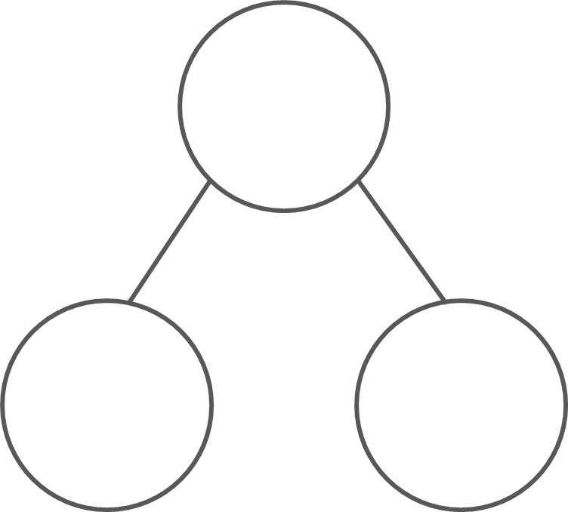
What are the hidden parts?
8
8
8
8
4
4
2
6
3
5
1
7
8 is made of ___ and ___;
___ and ___ make 8.
Mastering Number 2021/22 ncetm.org.uk

Slide 42
What are the hidden parts?
8
8
8
8
3
5
4
4
7
1
5
3
8 is made of ___ and ___;
___ and ___ make 8.
Mastering Number 2021/22 ncetm.org.uk

Slide 43
Practice task
Fill in the missing symbols
=
<
>
4 | + | 4 |  | 8
5 | + | 4 |  | 8
0 | + | 8 |  | 8
3 | + | 4 |  | 8
8 |  | 5 | + | 3
8 |  | 1 | + | 8
8 |  | 2 | + | 6
8 |  | 8 | + | 0
=
=
<
<
=
=
<
=
Mastering Number 2021/22 ncetm.org.uk

Slide 44
Practice task
Fill in the missing symbols
=
<
>
4 | + | 4 |  | 8
8 |  | 4 | + | 3
8 |  | 8 | + | 0
3 | + | 6 |  | 8
8 |  | 3 | + | 5
8 |  | 1 | + | 8
3 | + | 5 |  | 8
5 | + | 2 |  | 8
=
=
>
<
=
=
>
<
Mastering Number 2021/22 ncetm.org.uk

Slide 45
Complete the missing number calculations.
8 | - | 2 | =
8 | - | 5 | =
8 | - | 7 | =
6
3
1
8 | + |  | = | 8
3 | + |  | = | 8
4 | + |  | = | 8
0
5
4
8 | - | 8 | =
1 | + |  | = | 8
2 | + |  | = | 8
0
7
6
Mastering Number 2021/22 ncetm.org.uk

Slide 46
Mastering Number 2021/22 ncetm.org.uk

