Slide 1
Mastering Number
Retrieval Practice
Bonds of 7

Slide 2
Teacher Notes
This set of slides includes a selection of tasks for the children to re-visit bonds of 7 and provides an opportunity for you to assess their recall.
In the classroom you could also:
Use ‘call and response’ during transition times: ‘7 is made of 4 and …’ and the children respond with ‘… 3; 4 and 3 make 7.’
Make 7 on one row of the rekenrek then on two rows: start with ‘one push 4, now what do you need to make 7?’
Play ‘how many hiding?’ using 7 cubes and a cloth or bag.
At home:
Use the dot patterns to identify the bonds of 7.
Play ‘how many hiding?’ using any 7 objects and a cloth to hide some of the objects.
Mastering Number 2021/22 ncetm.org.uk

Slide 3
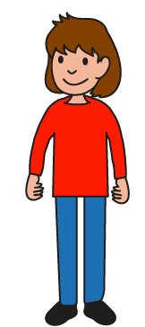
Can you find all the number bonds of 7 in these dice patterns?
Mastering Number 2021/22 ncetm.org.uk

Slide 4
7 is made of ___ and ___;
___ and ___ make 7.
Mastering Number 2021/22 ncetm.org.uk

Slide 5
Can you see number bonds of 7 in these dice patterns?
Say what you see!
Mastering Number 2021/22 ncetm.org.uk

Slide 6
7 is made of ___ and ___;
___ and ___ make 7.
Mastering Number 2021/22 ncetm.org.uk

Slide 7
7 is made of ___ and ___;
___ and ___ make 7.
Mastering Number 2021/22 ncetm.org.uk

Slide 8
7 is made of ___ and ___;
___ and ___ make 7.
Mastering Number 2021/22 ncetm.org.uk

Slide 9
7 is made of ___ and ___;
___ and ___ make 7.
Mastering Number 2021/22 ncetm.org.uk

Slide 10
7 is made of ___ and ___;
___ and ___ make 7.
Mastering Number 2021/22 ncetm.org.uk

Slide 11
7 is made of ___ and ___;
___ and ___ make 7.
Mastering Number 2021/22 ncetm.org.uk

Slide 12
7 is made of ___ and ___;
___ and ___ make 7.
Mastering Number 2021/22 ncetm.org.uk

Slide 13
7 is made of ___ and ___;
___ and ___ make 7.
Mastering Number 2021/22 ncetm.org.uk

Slide 14
7 is made of ___ and ___;
___ and ___ make 7.
Mastering Number 2021/22 ncetm.org.uk

Slide 15
7 is made of ___ and ___;
___ and ___ make 7.
Mastering Number 2021/22 ncetm.org.uk

Slide 16
7 is made of ___ and ___;
___ and ___ make 7.
Mastering Number 2021/22 ncetm.org.uk

Slide 17
7 is made of ___ and ___;
___ and ___ make 7.
Mastering Number 2021/22 ncetm.org.uk

Slide 18
7 is made of ___ and ___;
___ and ___ make 7.
Mastering Number 2021/22 ncetm.org.uk

Slide 19
Play ‘7 or NOT 7?’ with these dotty patterns!
Mastering Number 2021/22 ncetm.org.uk

Slide 20

7 or NOT 7?
Mastering Number 2021/22 ncetm.org.uk

Slide 21

7 or NOT 7?
Mastering Number 2021/22 ncetm.org.uk

Slide 22
7 or NOT 7?
Mastering Number 2021/22 ncetm.org.uk

Slide 23
7 or NOT 7?
Mastering Number 2021/22 ncetm.org.uk

Slide 24
7 or NOT 7?
Mastering Number 2021/22 ncetm.org.uk

Slide 25
7 or NOT 7?
Mastering Number 2021/22 ncetm.org.uk

Slide 26
7 or NOT 7?
Mastering Number 2021/22 ncetm.org.uk

Slide 27
Use your fingers to help you find and show what number is needed to make 7.
Can you say how many dots are missing?
Mastering Number 2021/22 ncetm.org.uk

Slide 28
___ needs ___ to make 7.
7 is made of ___ and ___.
Mastering Number 2021/22 ncetm.org.uk

Slide 29
___ needs ___ to make 7.
7 is made of ___ and ___.
Mastering Number 2021/22 ncetm.org.uk

Slide 30
___ needs ___ to make 7.
7 is made of ___ and ___.
Mastering Number 2021/22 ncetm.org.uk

Slide 31
___ needs ___ to make 7.
7 is made of ___ and ___.
Mastering Number 2021/22 ncetm.org.uk

Slide 32
___ needs ___ to make 7.
7 is made of ___ and ___.
Mastering Number 2021/22 ncetm.org.uk

Slide 33
___ needs ___ to make 7.
7 is made of ___ and ___.
Mastering Number 2021/22 ncetm.org.uk

Slide 34
___ needs ___ to make 7.
7 is made of ___ and ___.
Mastering Number 2021/22 ncetm.org.uk

Slide 35
___ needs ___ to make 7.
7 is made of ___ and ___.
Mastering Number 2021/22 ncetm.org.uk

Slide 36
Can you say the missing part of 7?
Mastering Number 2021/22 ncetm.org.uk

Slide 37
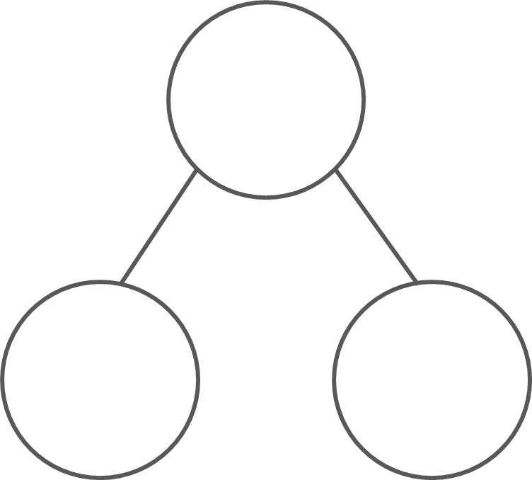
What are the hidden parts?
7
7
7
7
4
3
1
6
3
4
5
2
7 is made of ___ and ___;
___ and ___ make 7.
Mastering Number 2021/22 ncetm.org.uk

Slide 38
Practice task
Fill in the missing symbols
=
<
>
4 | + | 3 |  | 7
5 | + | 4 |  | 7
7 | + | 0 |  | 7
3 | + | 3 |  | 7
7 |  | 5 | + | 2
7 |  | 1 | + | 7
7 |  | 4 | + | 3
7 |  | 0 | + | 7
=
=
<
<
=
=
<
=
Mastering Number 2021/22 ncetm.org.uk

Slide 39
Practice task
Fill in the missing symbols
=
<
>
4 | + | 4 |  | 7
7 |  | 4 | + | 3
7 |  | 0 | + | 7
3 | + | 5 |  | 7
7 |  | 2 | + | 5
7 |  | 1 | + | 7
3 | + | 4 |  | 7
5 | + | 2 |  | 7
>
=
=
<
=
=
>
=
Mastering Number 2021/22 ncetm.org.uk

Slide 40
Complete the missing number calculations.
7 | - | 2 | =
7 | - | 5 | =
7 | - | 7 | =
5
2
0
7 | + |  | = | 7
2 | + |  | = | 7
4 | + |  | = | 7
0
5
3
7 | - | 4 | =
0 | + |  | = | 7
1 | + |  | = | 7
3
7
6
Mastering Number 2021/22 ncetm.org.uk

Slide 41
Mastering Number 2021/22 ncetm.org.uk

