Slide 1
Mastering Number
Retrieval Practice
Bonds of 6

Slide 2
Teacher Notes
This set of slides includes a selection of tasks for the children to re-visit bonds of 6 and provides an opportunity for you to assess their recall.
In the classroom you could also:
Use ‘call and response’ during transition times: ‘6 is made of 4 and …’ and the children respond with ‘… 2; 4 and 2 make 6.’
Make 6 on one row of the rekenrek then on two rows: start with ‘one push 4, now what do you need to make 6?’
Play ‘how many hiding?’ using an egg box and 6 cubes.
At home:
Record bonds of 6 using structured dot patterns provided.
Play ‘how many hiding?’ using an egg box or any 6 objects and a cloth to hide the objects in.
Mastering Number 2021/22 ncetm.org.uk

Slide 3
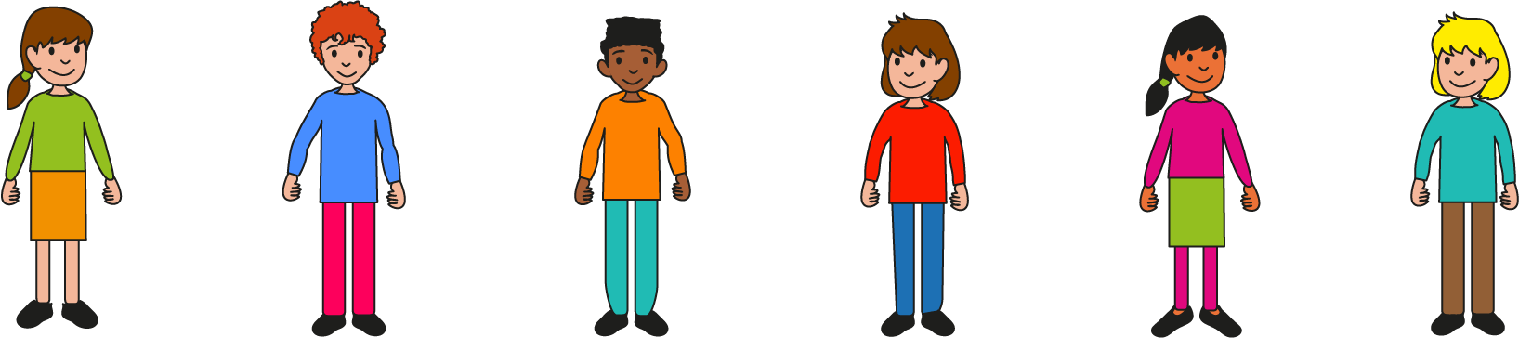
Can you say all the ways to make 6 using the 6-grid?
Mastering Number 2021/22 ncetm.org.uk

Slide 4
6 is made of ___ and ___;
___ and ___ make 6.
Mastering Number 2021/22 ncetm.org.uk

Slide 5
6 is made of ___ and ___;
___ and ___ make 6.
Mastering Number 2021/22 ncetm.org.uk

Slide 6
6 is made of ___ and ___;
___ and ___ make 6.
Mastering Number 2021/22 ncetm.org.uk

Slide 7
6 is made of ___ and ___;
___ and ___ make 6.
Mastering Number 2021/22 ncetm.org.uk

Slide 8
6 is made of ___ and ___;
___ and ___ make 6.
Mastering Number 2021/22 ncetm.org.uk

Slide 9
6 is made of ___ and ___;
___ and ___ make 6.
Mastering Number 2021/22 ncetm.org.uk

Slide 10
Now do it another way!
Mastering Number 2021/22 ncetm.org.uk

Slide 11
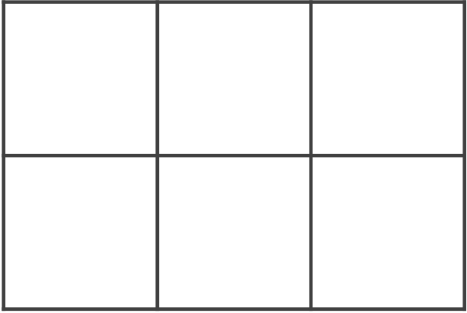
6 is made of ___ and ___;
___ and ___ make 6.
Mastering Number 2021/22 ncetm.org.uk

Slide 12
6 is made of ___ and ___;
___ and ___ make 6.
Mastering Number 2021/22 ncetm.org.uk

Slide 13
6 is made of ___ and ___;
___ and ___ make 6.
Mastering Number 2021/22 ncetm.org.uk

Slide 14
6 is made of ___ and ___;
___ and ___ make 6.
Mastering Number 2021/22 ncetm.org.uk

Slide 15
6 is made of ___ and ___;
___ and ___ make 6.
Mastering Number 2021/22 ncetm.org.uk

Slide 16
Can you see number bonds of 6 in these 6-grids?
Say what you see!
Mastering Number 2021/22 ncetm.org.uk

Slide 17
6 is made of ___ and ___;
___ and ___ make 6.
Mastering Number 2021/22 ncetm.org.uk

Slide 18
6 is made of ___ and ___;
___ and ___ make 6.
Mastering Number 2021/22 ncetm.org.uk

Slide 19
6 is made of ___ and ___;
___ and ___ make 6.
Mastering Number 2021/22 ncetm.org.uk

Slide 20
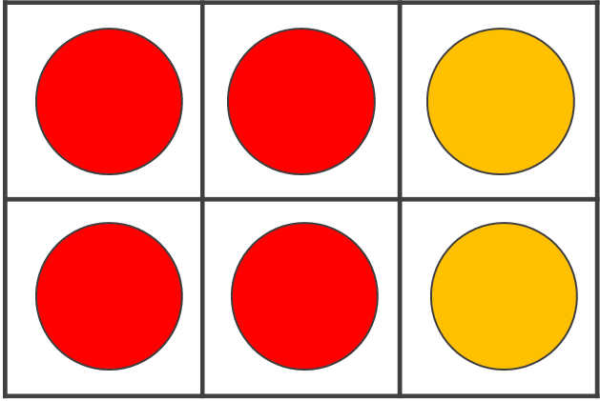
6 is made of ___ and ___;
___ and ___ make 6.
Mastering Number 2021/22 ncetm.org.uk

Slide 21
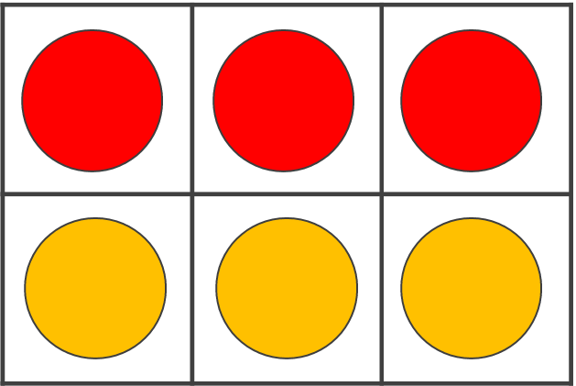
6 is made of ___ and ___;
___ and ___ make 6.
Mastering Number 2021/22 ncetm.org.uk

Slide 22
6 is made of ___ and ___;
___ and ___ make 6.
Mastering Number 2021/22 ncetm.org.uk

Slide 23
6 is made of ___ and ___;
___ and ___ make 6.
Mastering Number 2021/22 ncetm.org.uk

Slide 24
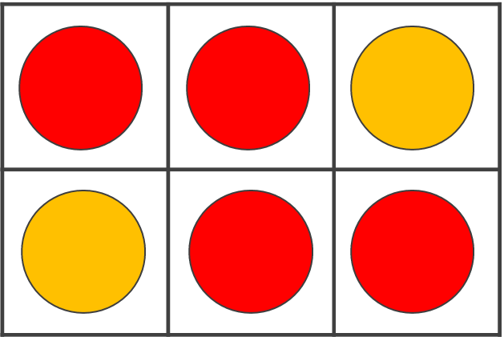
6 is made of ___ and ___;
___ and ___ make 6.
Mastering Number 2021/22 ncetm.org.uk

Slide 25
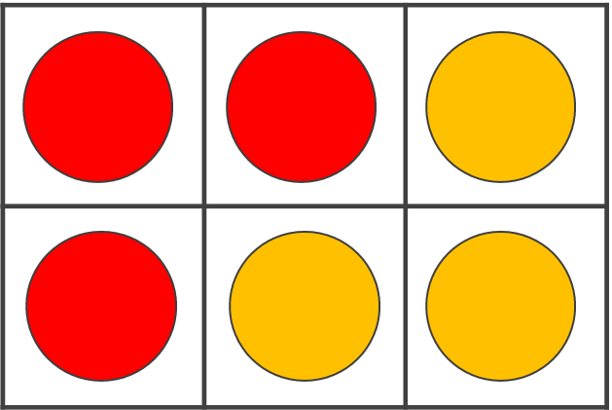
6 is made of ___ and ___;
___ and ___ make 6.
Mastering Number 2021/22 ncetm.org.uk

Slide 26
6 is made of ___ and ___;
___ and ___ make 6.
Mastering Number 2021/22 ncetm.org.uk

Slide 27
6 is made of ___ and ___;
___ and ___ make 6.
Mastering Number 2021/22 ncetm.org.uk

Slide 28
6 is made of ___ and ___;
___ and ___ make 6.
Mastering Number 2021/22 ncetm.org.uk

Slide 29
6 is made of ___ and ___;
___ and ___ make 6.
Mastering Number 2021/22 ncetm.org.uk

Slide 30
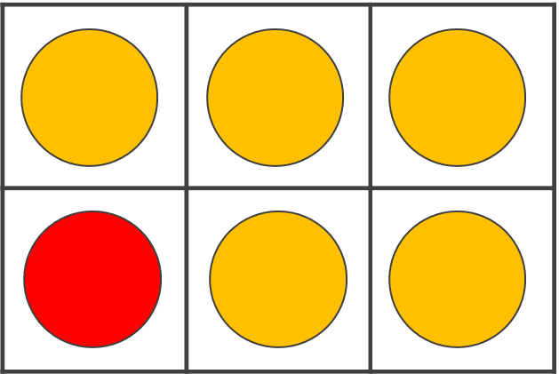
6 is made of ___ and ___;
___ and ___ make 6.
Mastering Number 2021/22 ncetm.org.uk

Slide 31
6 is made of ___ and ___;
___ and ___ make 6.
Mastering Number 2021/22 ncetm.org.uk

Slide 32
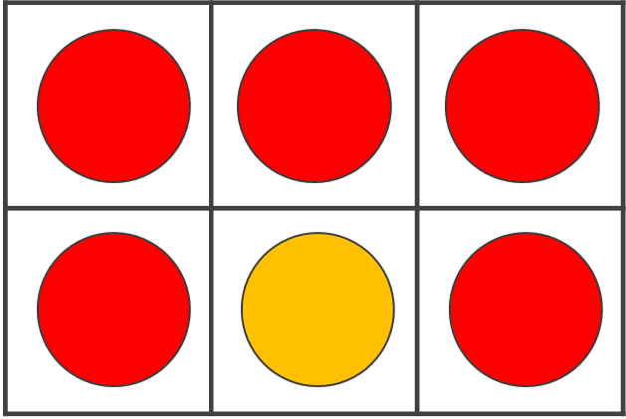
6 is made of ___ and ___;
___ and ___ make 6.
Mastering Number 2021/22 ncetm.org.uk

Slide 33
6 is made of ___ and ___;
___ and ___ make 6.
Mastering Number 2021/22 ncetm.org.uk

Slide 34
Maybe you can see different ways in the same pattern!
Can you see number bonds to 6 in these dotty patterns?
Say what you see!
Mastering Number 2021/22 ncetm.org.uk

Slide 35
6 is made of ___ and ___;
___ and ___ make 6.
Mastering Number 2021/22 ncetm.org.uk

Slide 36
6 is made of ___ and ___;
___ and ___ make 6.
Mastering Number 2021/22 ncetm.org.uk

Slide 37
6 is made of ___ and ___;
___ and ___ make 6.
Mastering Number 2021/22 ncetm.org.uk

Slide 38
6 is made of ___ and ___;
___ and ___ make 6.
Mastering Number 2021/22 ncetm.org.uk

Slide 39
6 is made of ___ and ___;
___ and ___ make 6.
Mastering Number 2021/22 ncetm.org.uk

Slide 40
6 is made of ___ and ___;
___ and ___ make 6.
Mastering Number 2021/22 ncetm.org.uk

Slide 41
6 is made of ___ and ___;
___ and ___ make 6.
Mastering Number 2021/22 ncetm.org.uk

Slide 42
Play ‘6 or NOT 6?’ with these dotty patterns!
Mastering Number 2021/22 ncetm.org.uk

Slide 43

6 or NOT 6?
Mastering Number 2021/22 ncetm.org.uk

Slide 44

6 or NOT 6?
Mastering Number 2021/22 ncetm.org.uk

Slide 45
6 or NOT 6?
Mastering Number 2021/22 ncetm.org.uk

Slide 46
6 or NOT 6?
Mastering Number 2021/22 ncetm.org.uk

Slide 47
6 or NOT 6?
Mastering Number 2021/22 ncetm.org.uk

Slide 48
6 or NOT 6?
Mastering Number 2021/22 ncetm.org.uk

Slide 49
6 or NOT 6?
Mastering Number 2021/22 ncetm.org.uk

Slide 50
4, 5 or 6?
Mastering Number 2021/22 ncetm.org.uk

Slide 51
Can you say how many dots are missing?
Mastering Number 2021/22 ncetm.org.uk

Slide 52
___ needs ___ to make 6.
6 is made of ___ and ___.
Mastering Number 2021/22 ncetm.org.uk

Slide 53
___ needs ___ to make 6.
6 is made of ___ and ___.
Mastering Number 2021/22 ncetm.org.uk

Slide 54
___ needs ___ to make 6.
6 is made of ___ and ___.
Mastering Number 2021/22 ncetm.org.uk

Slide 55
___ needs ___ to make 6.
6 is made of ___ and ___.
Mastering Number 2021/22 ncetm.org.uk

Slide 56
___ needs ___ to make 6.
6 is made of ___ and ___.
Mastering Number 2021/22 ncetm.org.uk

Slide 57
___ needs ___ to make 6.
6 is made of ___ and ___.
Mastering Number 2021/22 ncetm.org.uk

Slide 58
___ needs ___ to make 6.
6 is made of ___ and ___.
Mastering Number 2021/22 ncetm.org.uk

Slide 59
___ needs ___ to make 6.
6 is made of ___ and ___.
Mastering Number 2021/22 ncetm.org.uk

Slide 60
Can you say the missing part of 6?
Mastering Number 2021/22 ncetm.org.uk

Slide 61
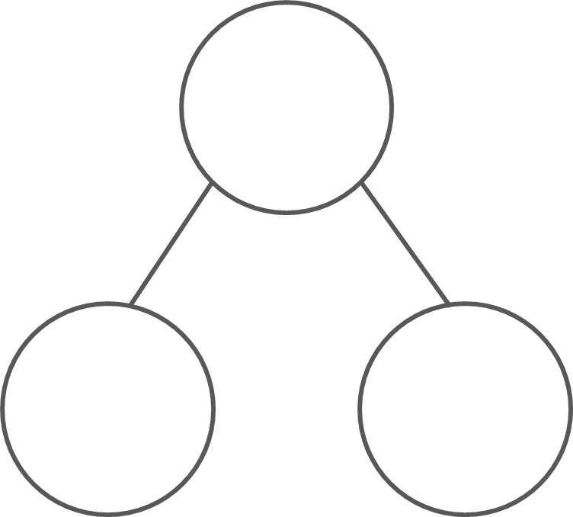
What are the hidden parts?
6
6
6
6
3
3
1
5
2
4
6
0
6 is made of ___ and ___;
___ and ___ make 6.
Mastering Number 2021/22 ncetm.org.uk

Slide 62
Practice task
Fill in the missing symbols
=
<
>
4 | + | 2 |  | 6
5 | + | 4 |  | 6
6 | + | 0 |  | 6
2 | + | 3 |  | 6
6 |  | 3 | + | 3
6 |  | 7 | + | 1
6 |  | 2 | + | 4
6 |  | 6 | + | 0
=
=
<
<
=
=
<
=
Mastering Number 2021/22 ncetm.org.uk

Slide 63
Practice task
Fill in the missing symbols
=
<
>
3 | + | 4 |  | 6
6 |  | 3 | + | 3
6 |  | 5 | + | 1
2 | + | 5 |  | 6
6 |  | 2 | + | 4
6 |  | 1 | + | 3
0 | + | 6 |  | 6
5 | + | 1 |  | 6
>
=
=
<
=
=
>
=
Mastering Number 2021/22 ncetm.org.uk

Slide 64
Complete the missing number calculations.
6 | - | 2 | =
6 | - | 5 | =
6 | - | 1 | =
4
1
5
3 | + |  | = | 6
2 | + |  | = | 13
1 | + |  | = | 6
3
4
5
6 | - | 6 | =
5 | + |  | = | 6
6 | + |  | = | 6
0
1
0
Mastering Number 2021/22 ncetm.org.uk

Slide 65
Mastering Number 2021/22 ncetm.org.uk

