Slide 1
Mastering Number
Retrieval Practice
Bonds of 5

Slide 2
Teacher Notes
This set of slides includes a selection of tasks for the children to re-visit bonds of 5 and provides an opportunity for you to assess their recall.
In the classroom you could also:
Use ‘call and response’ during transition times: ‘5 is made of 4 and …’ and the children respond with ‘… 1; 4 and 1 make 5.’
Make 5 on one row of the rekenrek then on two rows: start with ‘one push 4, now what do you need to make 5?’
Play ‘how many hiding?’ using 5 cubes and a cloth or bag.
At home:
Use the dot patterns to identify the bonds of 5.
Play ‘how many hiding?’ using any 5 objects and a cloth to hide some of the objects.
Mastering Number 2021/22 ncetm.org.uk

Slide 3
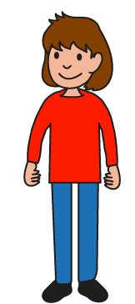
Can you find all the number bonds of 5 in these dice patterns?
Image © 2021 Alphablocks Ltd. All rights reserved. Mastering Number 2021/22 ncetm.org.uk

Slide 4
5 is made of ___ and ___;
___ and ___ make 5.
Mastering Number 2021/22 ncetm.org.uk

Slide 5
Can you see number bonds of 5 in these muddled dice patterns?
Say what you see!
Image © 2021 Alphablocks Ltd. All rights reserved. Mastering Number 2021/22 ncetm.org.uk

Slide 6
5 is made of ___ and ___;
___ and ___ make 5.
Mastering Number 2021/22 ncetm.org.uk

Slide 7
5 is made of ___ and ___;
___ and ___ make 5.
Mastering Number 2021/22 ncetm.org.uk

Slide 8
5 is made of ___ and ___;
___ and ___ make 5.
Mastering Number 2021/22 ncetm.org.uk

Slide 9
5 is made of ___ and ___;
___ and ___ make 5.
Mastering Number 2021/22 ncetm.org.uk

Slide 10
5 is made of ___ and ___;
___ and ___ make 5.
Mastering Number 2021/22 ncetm.org.uk

Slide 11
5 is made of ___ and ___;
___ and ___ make 5.
Mastering Number 2021/22 ncetm.org.uk

Slide 12
5 is made of ___ and ___;
___ and ___ make 5.
Mastering Number 2021/22 ncetm.org.uk

Slide 13
5 is made of ___ and ___;
___ and ___ make 5.
Mastering Number 2021/22 ncetm.org.uk

Slide 14
5 is made of ___ and ___;
___ and ___ make 5.
Mastering Number 2021/22 ncetm.org.uk

Slide 15
5 is made of ___ and ___;
___ and ___ make 5.
Mastering Number 2021/22 ncetm.org.uk

Slide 16
5 is made of ___ and ___;
___ and ___ make 5.
Mastering Number 2021/22 ncetm.org.uk

Slide 17
5 is made of ___ and ___;
___ and ___ make 5.
Mastering Number 2021/22 ncetm.org.uk

Slide 18
5 is made of ___ and ___;
___ and ___ make 5.
Mastering Number 2021/22 ncetm.org.uk

Slide 19
Play ‘5 or NOT 5?’ with these dotty patterns!
Image © 2021 Alphablocks Ltd. All rights reserved. Mastering Number 2021/22 ncetm.org.uk

Slide 20

5 or NOT 5?
Mastering Number 2021/22 ncetm.org.uk

Slide 21

5 or NOT 5?
Mastering Number 2021/22 ncetm.org.uk

Slide 22
5 or NOT 5?
Mastering Number 2021/22 ncetm.org.uk

Slide 23
5 or NOT 5?
Mastering Number 2021/22 ncetm.org.uk

Slide 24
5 or NOT 5?
Mastering Number 2021/22 ncetm.org.uk

Slide 25
5 or NOT 5?
Mastering Number 2021/22 ncetm.org.uk

Slide 26
5 or NOT 5?
Mastering Number 2021/22 ncetm.org.uk

Slide 27
Use your fingers to help you find and show what number is needed to make 5.
Can you say how many dots are missing?
Image © 2021 Alphablocks Ltd. All rights reserved. Mastering Number 2021/22 ncetm.org.uk

Slide 28
___ needs ___ to make 5.
5 is made of ___ and ___.
Mastering Number 2021/22 ncetm.org.uk

Slide 29
___ needs ___ to make 5.
5 is made of ___ and ___.
Mastering Number 2021/22 ncetm.org.uk

Slide 30
___ needs ___ to make 5.
5 is made of ___ and ___.
Mastering Number 2021/22 ncetm.org.uk

Slide 31
___ needs ___ to make 5.
5 is made of ___ and ___.
Mastering Number 2021/22 ncetm.org.uk

Slide 32
___ needs ___ to make 5.
5 is made of ___ and ___.
Mastering Number 2021/22 ncetm.org.uk

Slide 33
___ needs ___ to make 5.
5 is made of ___ and ___.
Mastering Number 2021/22 ncetm.org.uk

Slide 34
___ needs ___ to make 5.
5 is made of ___ and ___.
Mastering Number 2021/22 ncetm.org.uk

Slide 35
___ needs ___ to make 5.
5 is made of ___ and ___.
Mastering Number 2021/22 ncetm.org.uk

Slide 36
___ needs ___ to make 5.
5 is made of ___ and ___.
Mastering Number 2021/22 ncetm.org.uk

Slide 37
___ needs ___ to make 5.
5 is made of ___ and ___.
Mastering Number 2021/22 ncetm.org.uk

Slide 38
Can you say the missing part of 5?
Image © 2021 Alphablocks Ltd. All rights reserved. Mastering Number 2021/22 ncetm.org.uk

Slide 39
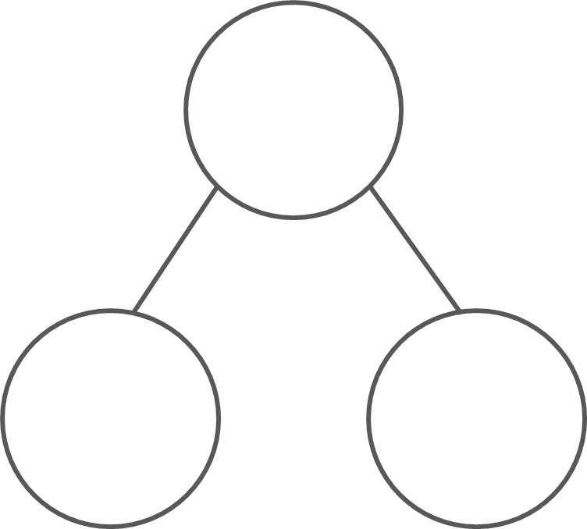
What are the hidden parts?
5
5
5
5
2
3
1
4
3
2
3
2
5 is made of ___ and ___;
___ and ___ make 5.
Mastering Number 2021/22 ncetm.org.uk

Slide 40
Practice task
Fill in the missing symbols
=
<
>
4 | + | 3 |  | 5
1 | + | 4 |  | 5
0 | + | 5 |  | 5
3 | + | 1 |  | 5
5 |  | 3 | + | 2
5 |  | 1 | + | 6
5 |  | 4 | + | 1
5 |  | 5 | + | 0
<
=
=
<
=
=
<
=
Mastering Number 2021/22 ncetm.org.uk

Slide 41
Practice task
Fill in the missing symbols
=
<
>
4 | + | 4 |  | 5
5 |  | 2 | + | 3
5 |  | 5 | + | 0
2 | + | 5 |  | 5
5 |  | 4 | + | 1
5 |  | 1 | + | 7
3 | + | 2 |  | 5
5 | + | 0 |  | 5
>
=
=
<
=
=
>
=
Mastering Number 2021/22 ncetm.org.uk

Slide 42
Complete the missing number calculations.
5 | - | 2 | =
5 | - | 5 | =
5 | - | 4 | =
3
0
1
2 | + |  | = | 5
4 | + |  | = | 5
3 | + |  | = | 5
3
1
2
5 | - | 1 | =
0 | + |  | = | 5
1 | + |  | = | 5
4
5
4
Mastering Number 2021/22 ncetm.org.uk

Slide 43
Mastering Number 2021/22 ncetm.org.uk

