Slide 1
Mastering Number
Retrieval Practice
Bonds of 10

Slide 2
Teacher Notes
This set of slides includes a selection of tasks for the children to re-visit bonds of 10 and provides an opportunity for you to assess their recall.
In the classroom you could also:
Use ‘call and response’ during transition times: ‘10 is made of 4 and …’ and the children respond with ‘… 6; 4 and 6 make 10.’
Make 10 on one row of the rekenrek then on two rows: start with ‘one push 4, now what do you need to make 10?’
Play ‘how many hiding?’ using 10 cubes and a cloth or bag.
At home:
Use the dot patterns to identify the bonds of 10.
Mastering Number 2021/22 ncetm.org.uk

Slide 3
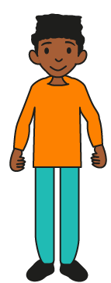
Can you find all the number bonds of 10 in the 10-frame?
Mastering Number 2021/22 ncetm.org.uk

Slide 4
10 is made of ___ and ___;
___ and ___ make 10.
Mastering Number 2021/22 ncetm.org.uk

Slide 5
10 is made of ___ and ___;
___ and ___ make 10.
Mastering Number 2021/22 ncetm.org.uk

Slide 6
Can you see number bonds of 10 in these 10-frames?
Say what you see!
Mastering Number 2021/22 ncetm.org.uk

Slide 7
10 is made of ___ and ___;
___ and ___ make 10.
Mastering Number 2021/22 ncetm.org.uk

Slide 8
10 is made of ___ and ___;
___ and ___ make 10.
Mastering Number 2021/22 ncetm.org.uk

Slide 9
10 is made of ___ and ___;
___ and ___ make 10.
Mastering Number 2021/22 ncetm.org.uk

Slide 10
10 is made of ___ and ___;
___ and ___ make 10.
Mastering Number 2021/22 ncetm.org.uk

Slide 11
10 is made of ___ and ___;
___ and ___ make 10.
Mastering Number 2021/22 ncetm.org.uk

Slide 12
10 is made of ___ and ___;
___ and ___ make 10.
Mastering Number 2021/22 ncetm.org.uk

Slide 13
10 is made of ___ and ___;
___ and ___ make 10.
Mastering Number 2021/22 ncetm.org.uk

Slide 14
10 is made of ___ and ___;
___ and ___ make 10.
Mastering Number 2021/22 ncetm.org.uk

Slide 15
10 is made of ___ and ___;
___ and ___ make 10.
Mastering Number 2021/22 ncetm.org.uk

Slide 16
10 is made of ___ and ___;
___ and ___ make 10.
Mastering Number 2021/22 ncetm.org.uk

Slide 17
10 is made of ___ and ___;
___ and ___ make 10.
Mastering Number 2021/22 ncetm.org.uk

Slide 18
10 is made of ___ and ___;
___ and ___ make 10.
Mastering Number 2021/22 ncetm.org.uk

Slide 19
10 is made of ___ and ___;
___ and ___ make 10.
Mastering Number 2021/22 ncetm.org.uk

Slide 20
10 is made of ___ and ___;
___ and ___ make 10.
Mastering Number 2021/22 ncetm.org.uk

Slide 21
10 is made of ___ and ___;
___ and ___ make 10.
Mastering Number 2021/22 ncetm.org.uk

Slide 22
10 is made of ___ and ___;
___ and ___ make 10.
Mastering Number 2021/22 ncetm.org.uk

Slide 23
10 is made of ___ and ___;
___ and ___ make 10.
Mastering Number 2021/22 ncetm.org.uk

Slide 24
10 is made of ___ and ___;
___ and ___ make 10.
Mastering Number 2021/22 ncetm.org.uk

Slide 25
10 is made of ___ and ___;
___ and ___ make 10.
Mastering Number 2021/22 ncetm.org.uk

Slide 26
10 is made of ___ and ___;
___ and ___ make 10.
Mastering Number 2021/22 ncetm.org.uk

Slide 27
Play ‘10 or NOT 10?’ with these dotty patterns!
Mastering Number 2021/22 ncetm.org.uk

Slide 28

10 or NOT 10?
Mastering Number 2021/22 ncetm.org.uk

Slide 29

10 or NOT 10?
Mastering Number 2021/22 ncetm.org.uk

Slide 30
10 or NOT 10?
Mastering Number 2021/22 ncetm.org.uk

Slide 31
10 or NOT 10?
Mastering Number 2021/22 ncetm.org.uk

Slide 32
10 or NOT 10?
Mastering Number 2021/22 ncetm.org.uk

Slide 33
10 or NOT 10?
Mastering Number 2021/22 ncetm.org.uk

Slide 34
10 or NOT 10?
Mastering Number 2021/22 ncetm.org.uk

Slide 35
10 or NOT 10?
Mastering Number 2021/22 ncetm.org.uk

Slide 36
10 or NOT 10?
Mastering Number 2021/22 ncetm.org.uk

Slide 37
10 or NOT 10?
Mastering Number 2021/22 ncetm.org.uk

Slide 38
Use your fingers to help you find and show what number is needed to make 10.
Can you say how many dots are missing?
Mastering Number 2021/22 ncetm.org.uk

Slide 39
___ needs ___ to make 10.
10 is made of ___ and ___.
Mastering Number 2021/22 ncetm.org.uk

Slide 40
___ needs ___ to make 10.
10 is made of ___ and ___.
Mastering Number 2021/22 ncetm.org.uk

Slide 41
___ needs ___ to make 10.
10 is made of ___ and ___.
Mastering Number 2021/22 ncetm.org.uk

Slide 42
___ needs ___ to make 10.
10 is made of ___ and ___.
Mastering Number 2021/22 ncetm.org.uk

Slide 43
___ needs ___ to make 10.
10 is made of ___ and ___.
Mastering Number 2021/22 ncetm.org.uk

Slide 44
___ needs ___ to make 10.
10 is made of ___ and ___.
Mastering Number 2021/22 ncetm.org.uk

Slide 45
___ needs ___ to make 10.
10 is made of ___ and ___.
Mastering Number 2021/22 ncetm.org.uk

Slide 46
___ needs ___ to make 10.
10 is made of ___ and ___.
Mastering Number 2021/22 ncetm.org.uk

Slide 47
___ needs ___ to make 10.
10 is made of ___ and ___.
Mastering Number 2021/22 ncetm.org.uk

Slide 48
___ needs ___ to make 10.
10 is made of ___ and ___
Mastering Number 2021/22 ncetm.org.uk

Slide 49
Can you say the missing part of 10?
Mastering Number 2021/22 ncetm.org.uk

Slide 50
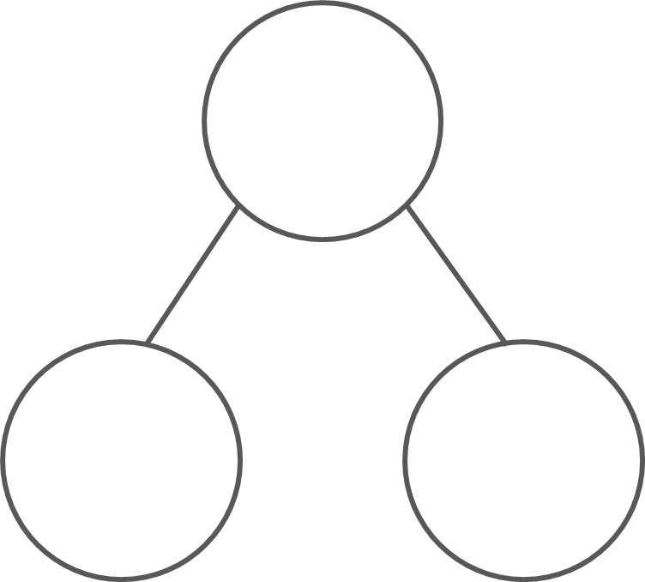
What are the hidden parts?
10
10
10
10
5
5
2
8
1
9
3
7
10 is made of ___ and ___;
___ and ___ make 10.
Mastering Number 2021/22 ncetm.org.uk

Slide 51
What are the hidden parts?
10
10
10
10
6
4
1
9
4
6
8
2
10 is made of ___ and ___;
___ and ___ make 10.
Mastering Number 2021/22 ncetm.org.uk

Slide 52
Practice task
Fill in the missing symbols
=
<
>
=
4 | + | 5 |  | 10
8 | + | 2 |  | 10
10 | + | 0 |  | 10
3 | + | 8 |  | 10
10 |  | 1 | + | 9
10 |  | 4 | + | 4
10 |  | 3 | + | 7
10 |  | 5 | + | 6
<
=
<
=
=
<
>
Mastering Number 2021/22 ncetm.org.uk

Slide 53
Practice task
Fill in the missing symbols
=
<
>
6 | + | 6 |  | 10
10 |  | 2 | + | 8
10 |  | 7 | + | 3
6 | + | 3 |  | 10
>
10 |  | 1 | + | 9
10 |  | 9 | + | 0
5 | + | 5 |  | 10
2 | + | 8 |  | 10
=
=
<
=
=
>
=
Mastering Number 2021/22 ncetm.org.uk

Slide 54
Complete the missing number calculations.
10 | - | 2 | =
10 | - | 9 | =
10 | - | 5 | =
8
1
5
6 | + |  | = | 10
3 | + |  | = | 10
1 | + |  | = | 10
4
7
9
10 | - | 6 | =
0 | + |  | = | 10
8 | + |  | = | 10
4
10
2
Mastering Number 2021/22 ncetm.org.uk

Slide 55
Complete the missing number calculations.
10 | - | 3 | =
10 | - | 4 | =
10 | - | 10 | =
7
6
0
9 | + |  | = | 10
7 | + |  | = | 10
5 | + |  | = | 10
1
3
5
10 | - | 1 | =
2 | + |  | = | 10
10 | + |  | = | 10
9
8
0
Mastering Number 2021/22 ncetm.org.uk

Slide 56
Mastering Number 2021/22 ncetm.org.uk

