Slide 1
Retrieval Practice
‘5 and a bit’

Slide 2
Teacher Notes
This set of slides includes a selection of tasks which allow the children to re-visit the composition of the numbers 6 to 9 as ‘5 and a bit’, and provide an opportunity for you to assess the children’s recall.
In the classroom you could also:
Use ‘call and response’ during transition times; e.g. ‘8 is made of 5 and…’. Children respond: ‘3. 5 and 3 make 8’
Make 6, 7, 8 or 9 on 1 row of the rekenrek: start with ‘one push 5, now what do you need to make (6, 7, 8 or 9)?’
Play ‘how many hiding?’ using 6, 7, 8 or 9 cubes and a cloth or bag, always starting with 5 cubes visible. Say: ‘If there are 8 cubes altogether, how many are hiding?’
Mastering Number 2021/22 ncetm.org.uk

Slide 3
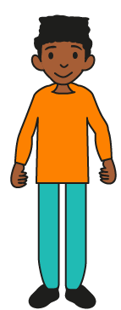
Can you show the SAME pattern on your fingers and SAY the number you have made?
Mastering Number 2021/22 ncetm.org.uk

Slide 4
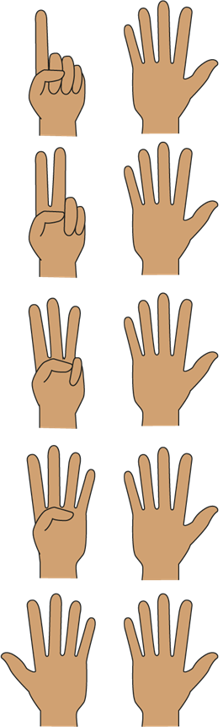
6
Mastering Number 2021/22 ncetm.org.uk

Slide 5
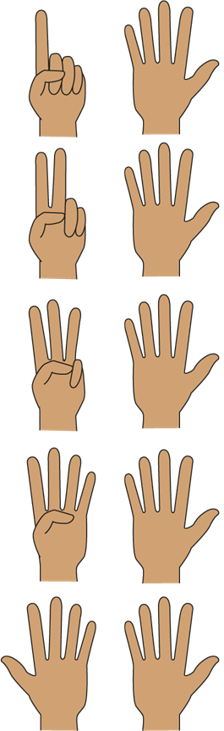
9
Mastering Number 2021/22 ncetm.org.uk

Slide 6
7
Mastering Number 2021/22 ncetm.org.uk

Slide 7
8
Mastering Number 2021/22 ncetm.org.uk

Slide 8
Then say how each number is made using the stem sentence.
Make the SAME number that you can see on the finger patterns using a rekenrek - use just ONE push!
Mastering Number 2021/22 ncetm.org.uk

Slide 9
9
_____ is made of 5 and _____ ;
5 and _____ make _____ .
Mastering Number 2021/22 ncetm.org.uk

Slide 10
6
_____ is made of 5 and _____ ;
5 and _____ make _____ .
Mastering Number 2021/22 ncetm.org.uk

Slide 11
8
_____ is made of 5 and _____ ;
5 and _____ make _____ .
Mastering Number 2021/22 ncetm.org.uk

Slide 12
7
_____ is made of 5 and _____ ;
5 and _____ make _____ .
Mastering Number 2021/22 ncetm.org.uk

Slide 13
Say how many counters are needed to make the number shown.
Mastering Number 2021/22 ncetm.org.uk

Slide 14
Make 7
5 needs _____ to make _____ .
Mastering Number 2021/22 ncetm.org.uk

Slide 15
Make 6
5 needs _____ to make _____ .
Mastering Number 2021/22 ncetm.org.uk

Slide 16
Make 9
5 needs _____ to make _____ .
Mastering Number 2021/22 ncetm.org.uk

Slide 17
Make 8
5 needs _____ to make _____ .
Mastering Number 2021/22 ncetm.org.uk

Slide 18
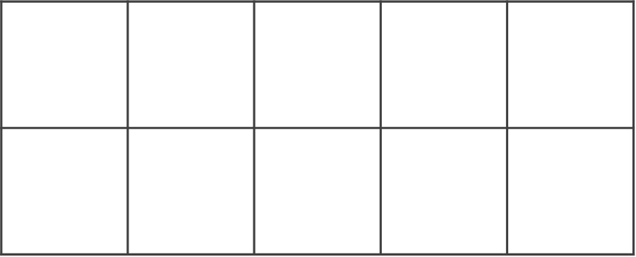
Make 8
5 needs _____ to make _____ .
Mastering Number 2021/22 ncetm.org.uk

Slide 19
Make 6
5 needs _____ to make _____ .
Mastering Number 2021/22 ncetm.org.uk

Slide 20
Make 7
5 needs _____ to make _____ .
Mastering Number 2021/22 ncetm.org.uk

Slide 21
Make 9
5 needs _____ to make _____ .
Mastering Number 2021/22 ncetm.org.uk

Slide 22
Can you say how many animals are hiding if I tell you how many there are altogether?
Mastering Number 2021/22 ncetm.org.uk

Slide 23

There are 6 kittens altogether… how many are hiding?
5 needs _____ to make _____ .
Mastering Number 2021/22 ncetm.org.uk

Slide 24

There are 9 spotty snails altogether… how many are hiding?
5 needs _____ to make _____ .
Mastering Number 2021/22 ncetm.org.uk

Slide 25
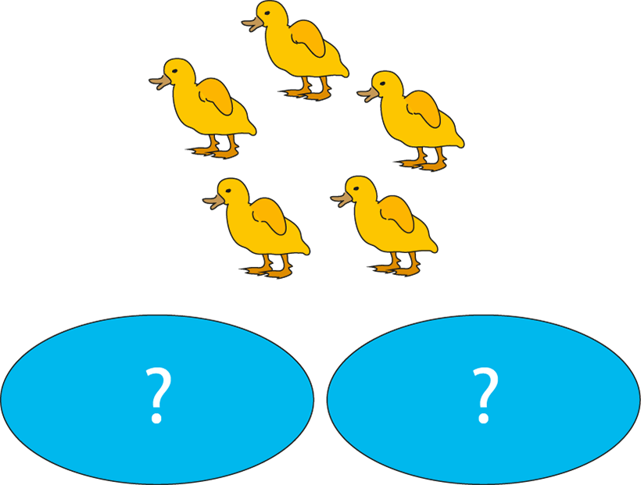
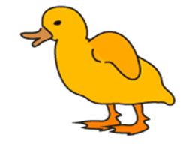
There are 7 ducklings altogether… how many are hiding?
5 needs _____ to make _____ .
Mastering Number 2021/22 ncetm.org.uk

Slide 26

There are 8 stripy snails altogether… how many are hiding?
5 needs _____ to make _____ .
Mastering Number 2021/22 ncetm.org.uk

Slide 27
Say whether the same or a different number is shown.
Mastering Number 2021/22 ncetm.org.uk

Slide 28

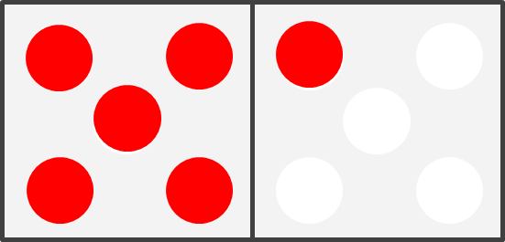
Same or different?
6
6
Mastering Number 2021/22 ncetm.org.uk

Slide 29
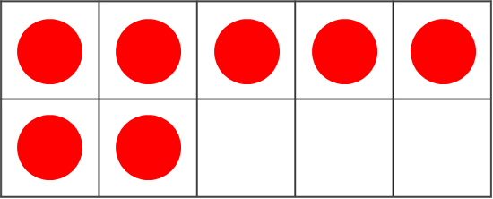
Same or different?
6
7
Mastering Number 2021/22 ncetm.org.uk

Slide 30
Same or different?
7
7
Mastering Number 2021/22 ncetm.org.uk

Slide 31
Same or different?
6
8
Mastering Number 2021/22 ncetm.org.uk

Slide 32
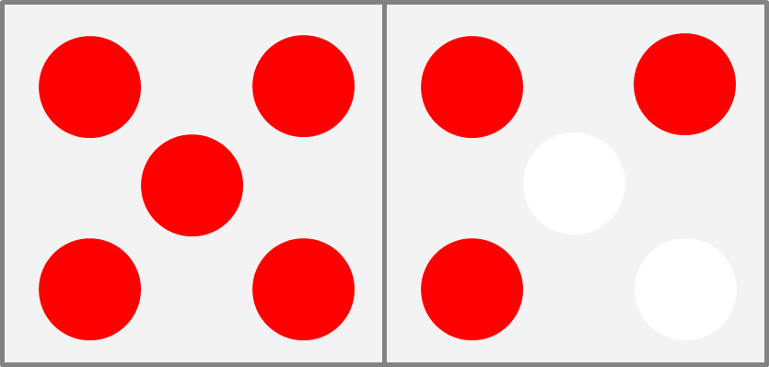
Same or different?
8
8
Mastering Number 2021/22 ncetm.org.uk

Slide 33
Same or different?
9
9
Mastering Number 2021/22 ncetm.org.uk

Slide 34
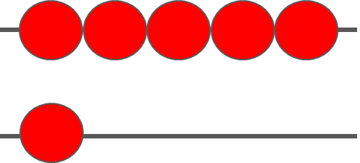
Same or different?
6
6
Mastering Number 2021/22 ncetm.org.uk

Slide 35
Can you say the missing part of each number?
Mastering Number 2021/22 ncetm.org.uk

Slide 36
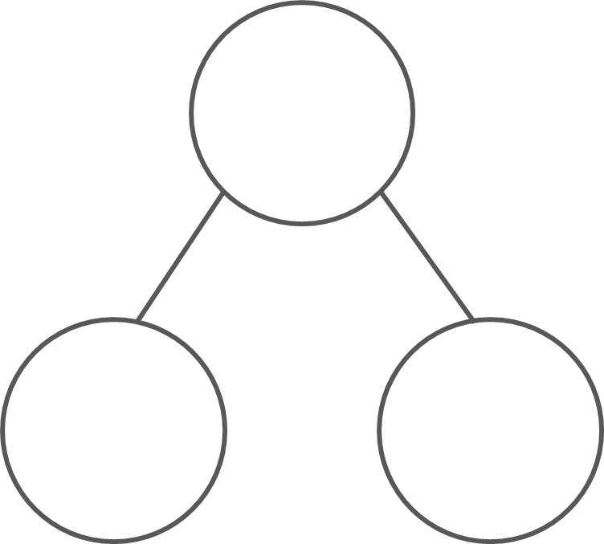
What are the hidden parts?
6
7
8
9
1
5
2
5
5
3
5
4
_____ is made of 5 and _____ ;
5 and _____ make _____ .
Mastering Number 2021/22 ncetm.org.uk

Slide 37
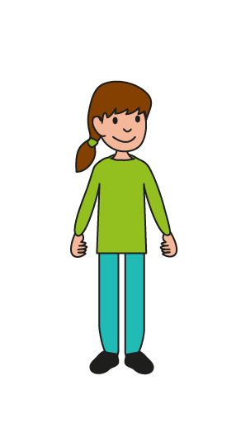
Can you say which numbers are hidden in my equations to match the number story?
Mastering Number 2021/22 ncetm.org.uk

Slide 38


There are 5 red cars and 3 blue cars.
There are ____ cars altogether.
5 | + | 3 | = | 8
Mastering Number 2021/22 ncetm.org.uk

Slide 39
There are 5 small snails and 2 big snails.
There are ____ snails altogether.
5 | + | 2 | = | 7
Mastering Number 2021/22 ncetm.org.uk

Slide 40


There are 5 buns with cherries and 1 without a cherry.
There are ____ buns altogether.
5 | + | 1 | = | 6
Mastering Number 2021/22 ncetm.org.uk

Slide 41
There are 5 spotty snails and 4 stripy snails.
There are ____ snails altogether.
5 | + | 4 | = | 9
Mastering Number 2021/22 ncetm.org.uk

Slide 42
Can you check that my equations are correct?
Mastering Number 2021/22 ncetm.org.uk

Slide 43


5 | + | 2 | = | 7
2 | + | 5 | = | 7
5 | + | 3 | = | 9
5 | + | 3 | = | 8
5 | + | 4 | = | 10
5 | + | 4 | = | 9
1 | + | 5 | = | 6
5 | + | 1 | = | 6
3 | + | 5 | = | 8
4 | + | 5 | = | 8
Mastering Number 2021/22 ncetm.org.uk

Slide 44
Can you say the total/sum for each equation?
Mastering Number 2021/22 ncetm.org.uk

Slide 45
5 | + | 4 | = | 9
Mastering Number 2021/22 ncetm.org.uk

Slide 46
4 | + | 5 | = | 9
Mastering Number 2021/22 ncetm.org.uk

Slide 47
3 | + | 5 | = | 8
Mastering Number 2021/22 ncetm.org.uk

Slide 48
5 | + | 3 | = | 8
Mastering Number 2021/22 ncetm.org.uk

Slide 49
5 | + | 1 | = | 6
Mastering Number 2021/22 ncetm.org.uk

Slide 50
5 | + | 2 | = | 7
Mastering Number 2021/22 ncetm.org.uk

Slide 51
2 | + | 5 | = | 7
Mastering Number 2021/22 ncetm.org.uk

Slide 52
1 | + | 5 | = | 6
Mastering Number 2021/22 ncetm.org.uk

Slide 53
5 | + | 4 | = | 9
Mastering Number 2021/22 ncetm.org.uk

Slide 54
5 | + | 2 | = | 7
Mastering Number 2021/22 ncetm.org.uk

Slide 55
4 | + | 5 | = | 9
Mastering Number 2021/22 ncetm.org.uk

Slide 56
5 | + | 3 | = | 8
Mastering Number 2021/22 ncetm.org.uk

Slide 57
3 | + | 5 | = | 8
Mastering Number 2021/22 ncetm.org.uk

