Slide 1
Retrieval Practice
‘10 and a bit’

Slide 2
Teacher Notes
This set of slides include a selection of tasks which allow the children to re-visit the composition of the numbers 11 to 19, when 10 is a part, and provide an opportunity for you to assess their recall.
In the classroom you could also:
Use ‘call and response’ during transition times; e.g. ‘12 is made of 10 and…’. Children respond: ‘2. 10 and 2 is 12.’
Mastering Number 2021/22 ncetm.org.uk

Slide 3

Say the number you can see.
Mastering Number 2021/22 ncetm.org.uk

Slide 4
12
Twelve
_____ is made of 10 and _____ ;
10 and _____ make _____ .
Mastering Number 2021/22 ncetm.org.uk

Slide 5
15
Fifteen
_____ is made of 10 and _____ ;
10 and _____ make _____ .
Mastering Number 2021/22 ncetm.org.uk

Slide 6
19
Nineteen
_____ is made of 10 and _____ ;
10 and _____ make _____ .
Mastering Number 2021/22 ncetm.org.uk

Slide 7
13
Thirteen
_____ is made of 10 and _____ ;
10 and _____ make _____ .
Mastering Number 2021/22 ncetm.org.uk

Slide 8
14
Fourteen
_____ is made of 10 and _____ ;
10 and _____ make _____ .
Mastering Number 2021/22 ncetm.org.uk

Slide 9
17
Seventeen
_____ is made of 10 and _____ ;
10 and _____ make _____ .
Mastering Number 2021/22 ncetm.org.uk

Slide 10
16
Sixteen
_____ is made of 10 and _____ ;
10 and _____ make _____ .
Mastering Number 2021/22 ncetm.org.uk

Slide 11
18
Eighteen
_____ is made of 10 and _____ ;
10 and _____ make _____ .
Mastering Number 2021/22 ncetm.org.uk

Slide 12
11
Eleven
Mastering Number 2021/22 ncetm.org.uk

Slide 13
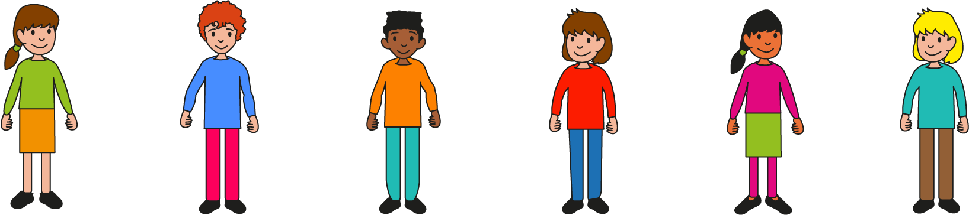
Say how many more to make the number shown. Use your rekenrek if you need to!
Mastering Number 2021/22 ncetm.org.uk

Slide 14
Make 11
10 needs _____ to make _____ ;
_____ is made of 10 and _____ .
Mastering Number 2021/22 ncetm.org.uk

Slide 15
Make 15
10 needs _____ to make _____ ;
_____ is made of 10 and _____ .
Mastering Number 2021/22 ncetm.org.uk

Slide 16
Make 14
10 needs _____ to make _____ ;
_____ is made of 10 and _____ .
Mastering Number 2021/22 ncetm.org.uk

Slide 17
Make 12
10 needs _____ to make _____ ;
_____ is made of 10 and _____ .
Mastering Number 2021/22 ncetm.org.uk

Slide 18
Make 13
10 needs _____ to make _____ ;
_____ is made of 10 and _____ .
Mastering Number 2021/22 ncetm.org.uk

Slide 19
Make 16
10 needs _____ to make _____ ;
_____ is made of 10 and _____ .
Mastering Number 2021/22 ncetm.org.uk

Slide 20
Make 19
10 needs _____ to make _____ ;
_____ is made of 10 and _____ .
Mastering Number 2021/22 ncetm.org.uk

Slide 21
Make 17
10 needs _____ to make _____ ;
_____ is made of 10 and _____ .
Mastering Number 2021/22 ncetm.org.uk

Slide 22
Make 18
10 needs _____ to make _____ ;
_____ is made of 10 and _____ .
Mastering Number 2021/22 ncetm.org.uk

Slide 23
Can you spot if I have written the correct number to match the picture?
Mastering Number 2021/22 ncetm.org.uk

Slide 24

18
Mastering Number 2021/22 ncetm.org.uk

Slide 25
19
Mastering Number 2021/22 ncetm.org.uk

Slide 26
15
17
Mastering Number 2021/22 ncetm.org.uk

Slide 27
16
61
Mastering Number 2021/22 ncetm.org.uk

Slide 28
14
Mastering Number 2021/22 ncetm.org.uk

Slide 29
13
31
Mastering Number 2021/22 ncetm.org.uk

Slide 30
12
Mastering Number 2021/22 ncetm.org.uk

Slide 31
10
11
Mastering Number 2021/22 ncetm.org.uk

Slide 32
Can you say what the missing numbers are in the part-part-whole diagrams?
Mastering Number 2021/22 ncetm.org.uk

Slide 33
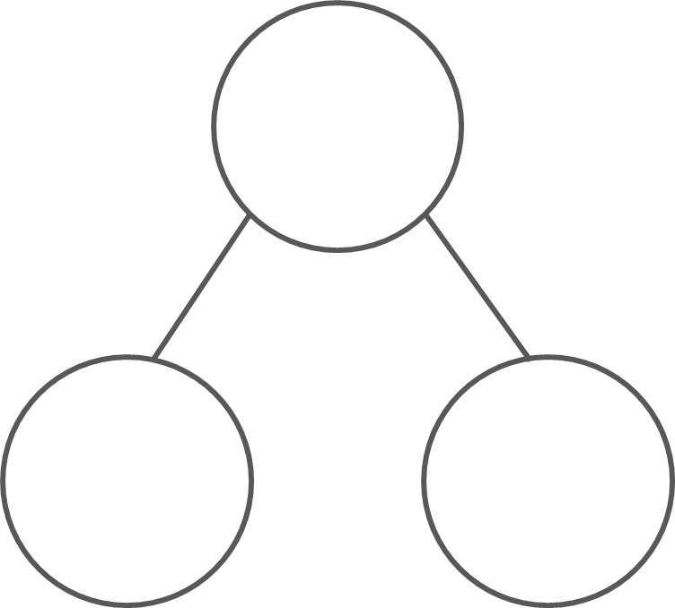
What are the hidden parts?
11
12
13
10
1
10
2
10
3
14
15
10
4
5
10
_____ is made of 10 and _____ ;
10 and _____ make _____ .
Mastering Number 2021/22 ncetm.org.uk

Slide 34
Find the missing whole
14
11
12
10
4
10
1
10
2
13
15
10
3
5
10
10 plus _____ is _____ .
Mastering Number 2021/22 ncetm.org.uk

Slide 35
Find the missing part or the missing whole
15
12
11
13
14
10
5
10
2
10
1
10
3
4
10
12
14
15
11
13
10
2
10
4
10
5
10
1
3
10
Mastering Number 2021/22 ncetm.org.uk

Slide 36
Can you say the missing number in each of these equations?
Mastering Number 2021/22 ncetm.org.uk

Slide 37
10 | + |  | = | 11
10 | + |  | = | 12
1
2
10 | + |  | = | 15
10 | + |  | = | 13
5
3
10 | + |  | = | 14
10 | + |  | = | 19
4
9
10 | + |  | = | 17
8
7
10 | + |  | = | 18
10 | + |  | = | 16
10 | + |  | = | 20
6
10
Mastering Number 2021/22 ncetm.org.uk

Slide 38
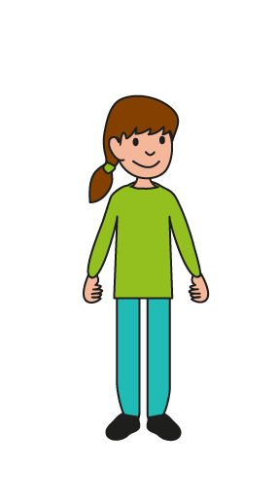
Can you check that my equations are correct?
Mastering Number 2021/22 ncetm.org.uk

Slide 39

10 | + | 2 | = | 12
10 | + | 1 | = | 11
10 | + | 5 | = | 13
10 | + | 7 | = | 17
10 | + | 4 | = | 41
10 | + | 3 | = | 13
10 | + | 9 | = | 19
10 | + | 8 | = | 18
10 | + | 6 | = | 61
10 | + | 6 | = | 16
Mastering Number 2021/22 ncetm.org.uk

Slide 40
Can you say the total/sum for each equation?
Mastering Number 2021/22 ncetm.org.uk

Slide 41
10 | + | 5 | = | 15
Mastering Number 2021/22 ncetm.org.uk

Slide 42
5 | + | 10 | = | 15
Mastering Number 2021/22 ncetm.org.uk

Slide 43
10 | + | 2 | = | 12
Mastering Number 2021/22 ncetm.org.uk

Slide 44
2 | + | 10 | = | 12
Mastering Number 2021/22 ncetm.org.uk

Slide 45
7 | + | 10 | = | 17
Mastering Number 2021/22 ncetm.org.uk

Slide 46
10 | + | 7 | = | 17
Mastering Number 2021/22 ncetm.org.uk

Slide 47
10 | + | 9 | = | 19
Mastering Number 2021/22 ncetm.org.uk

Slide 48
9 | + | 10 | = | 19
Mastering Number 2021/22 ncetm.org.uk

Slide 49
1 | + | 10 | = | 11
Mastering Number 2021/22 ncetm.org.uk

Slide 50
10 | + | 1 | = | 11
Mastering Number 2021/22 ncetm.org.uk

Slide 51
10 | + | 6 | = | 16
Mastering Number 2021/22 ncetm.org.uk

Slide 52
6 | + | 10 | = | 16
Mastering Number 2021/22 ncetm.org.uk

Slide 53
10 | + | 3 | = | 13
Mastering Number 2021/22 ncetm.org.uk

Slide 54
3 | + | 10 | = | 13
Mastering Number 2021/22 ncetm.org.uk

Slide 55
10 | + | 8 | = | 18
Mastering Number 2021/22 ncetm.org.uk

Slide 56
8 | + | 10 | = | 18
Mastering Number 2021/22 ncetm.org.uk

Slide 57
4 | + | 10 | = | 14
Mastering Number 2021/22 ncetm.org.uk

Slide 58
10 | + | 4 | = | 14
Mastering Number 2021/22 ncetm.org.uk

