Slide 1

Reading in EYFS
October 2025

Slide 2





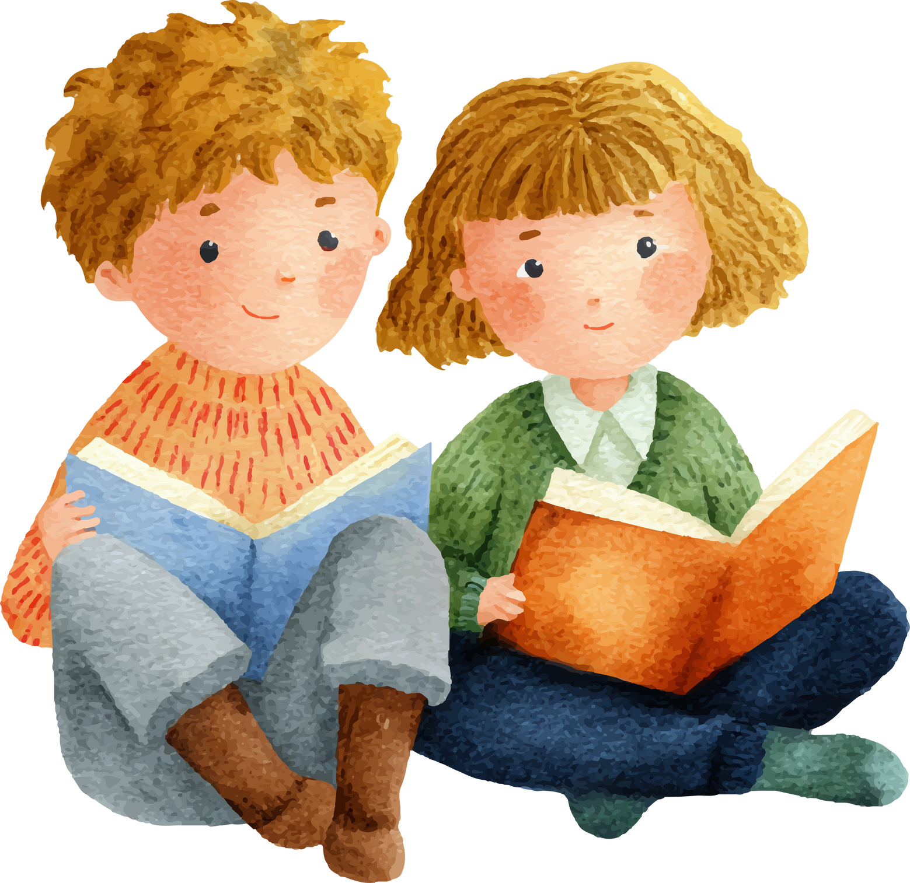


Welcome to Reading in Early Years Foundation Stage
Discover how we teach reading and how you can help your child at home.

Slide 3


Why is reading important?
Reading for pleasure benefits children’s wellbeing, social skills, imagination, independence and confidence.
Reading supports and enhances a child’s vocabulary; it fosters and enhances creativity and imagination.
Reading is a key life skill - It supports all other curriculum areas of learning.

Slide 4

What we do to teach your child to read
Phonics
Communication and language lessons
Phonological Awareness
Daily Reading lessons
.Sound-letter relationships
.Decoding words
.Building reading skills
. Understanding of language structure
. Environmental sounds
. Rhyme
. Alliteration
. Blending / Segmenting
. Understanding text meaning
. Asking questions
. Discussing stories
. Language rich curriculum
. Daily singing / rhyme / story time

Slide 5


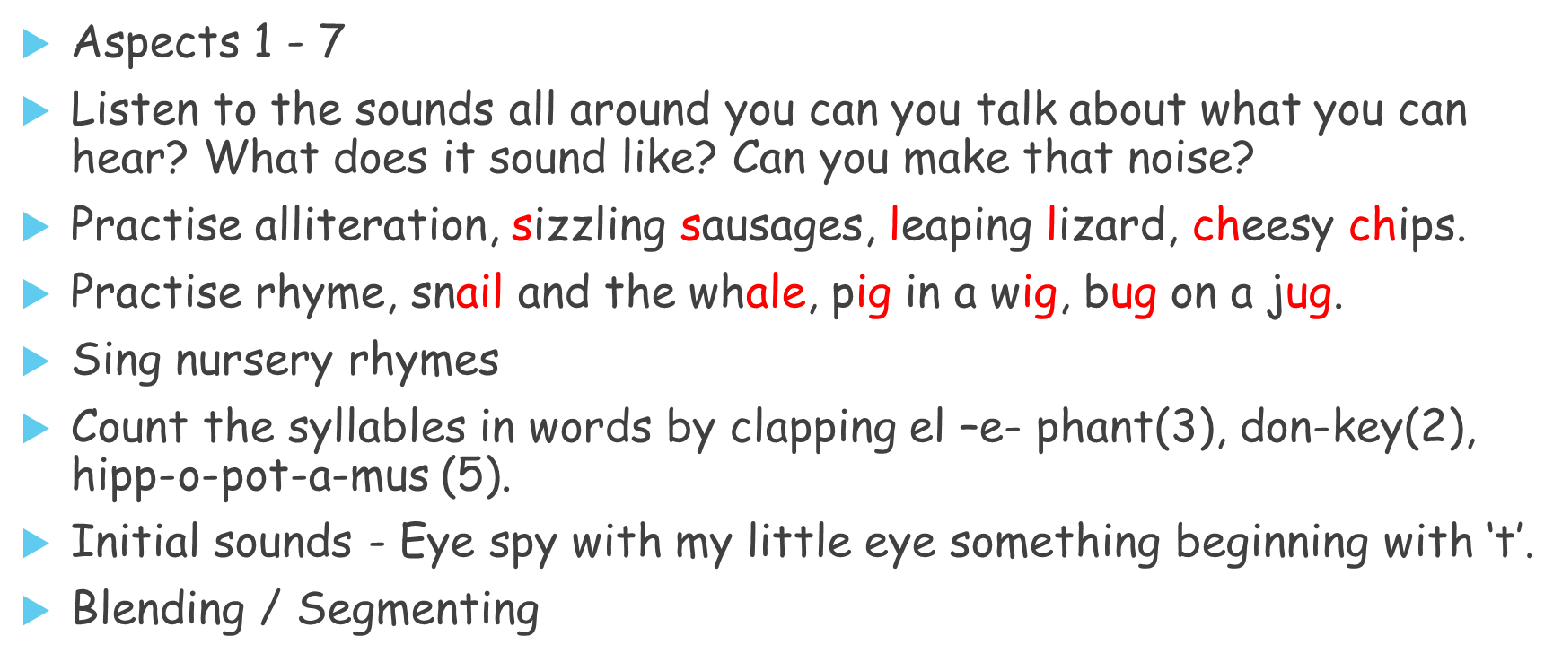
Phonological Awareness

Slide 6
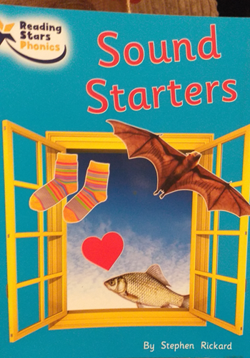
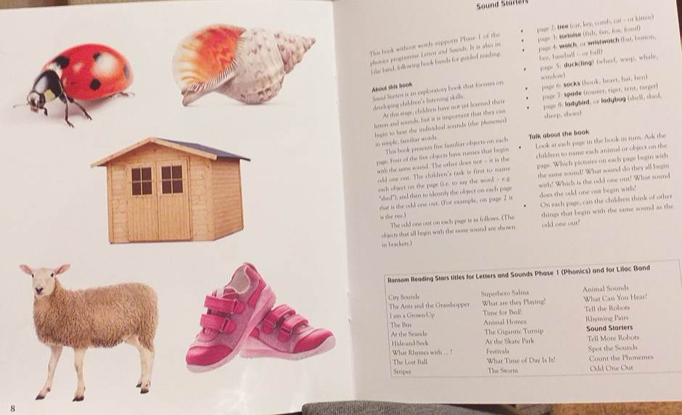
Books that develop Phonological Awareness

Slide 7
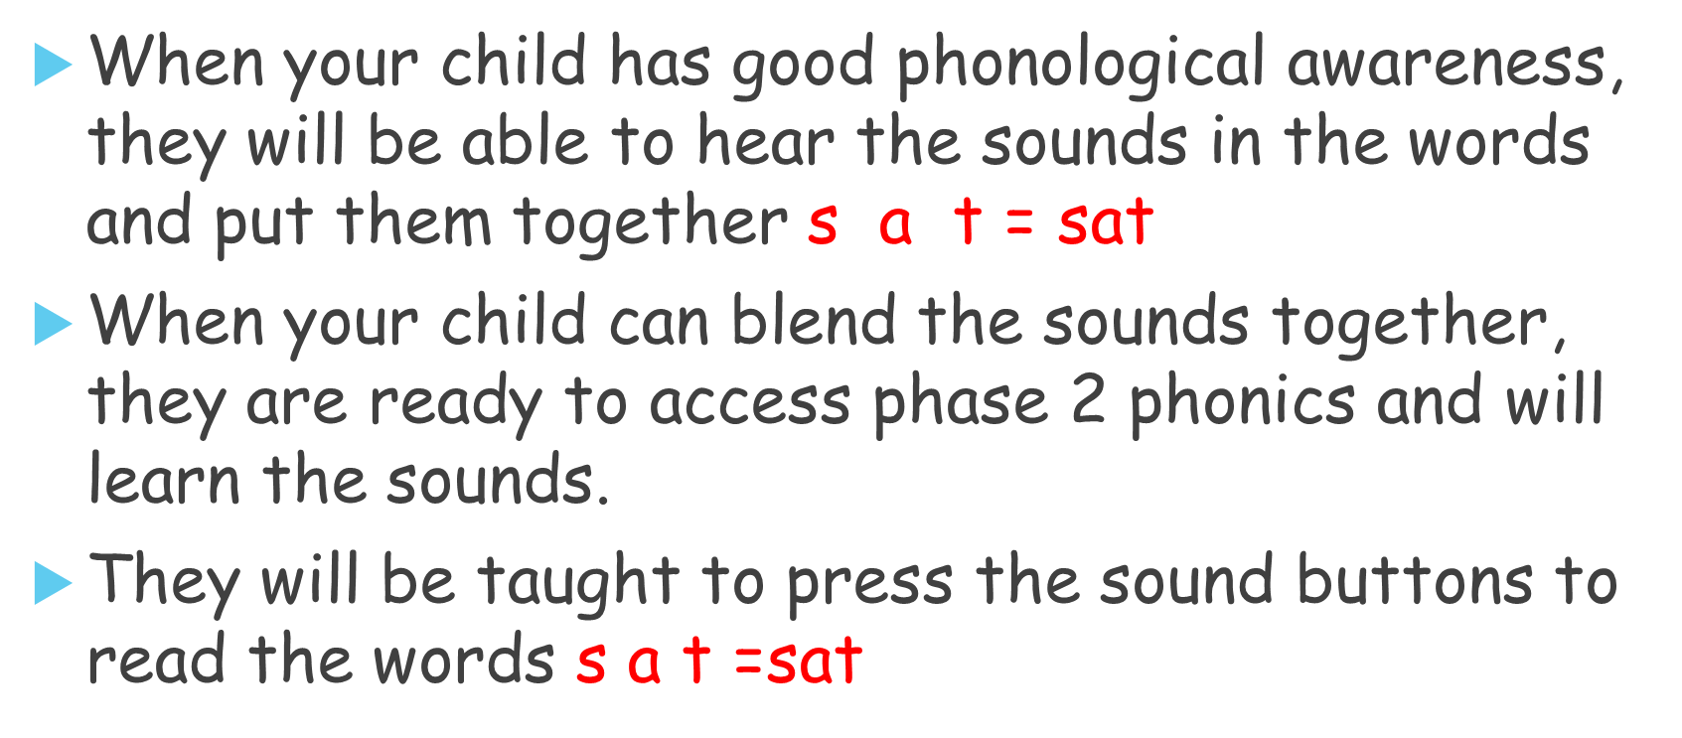
Blending / Segmenting

Slide 8
Top tips for teaching the children the sounds.
It is important for a child to learn lower case letters rather than capital letters at first. In phonics lessons we teach
‘the sound is …. the letter name is …’
Most early books and games use lower case letters. Don’t shy away from talking about when you see or use a capital letter e.g. at the beginning of sentences or a child’s name.
When you talk about letters / reading with your child use the letter sounds ‘a buh
cuh duh e’ The reason for this is that sounding out words is practically impossible if you use the letter names e.g: cat would sound like ‘see ay tee’
Talk to the children about letters and sounds. Children enjoy their phonics and reading and once they begin to recognise more letters and words, they can read signs, labels, notes, magazines and lots of things around us.

Slide 9
What is phonics?
Systematic Synthetic phonics is the approach we use to teach reading.
The phonemes (sounds) associated with graphemes (letters) are pronounced and blended.
Children are taught to take a single - syllable word
e.g.: cat it is taken apart into three letters, pronounced a phoneme for each letter in turn
c a t and blend the phonemes together to form the word cat.
Phonics is when sounds are blended to read words and when words are broken down into sounds, we segment for spelling.

Slide 10
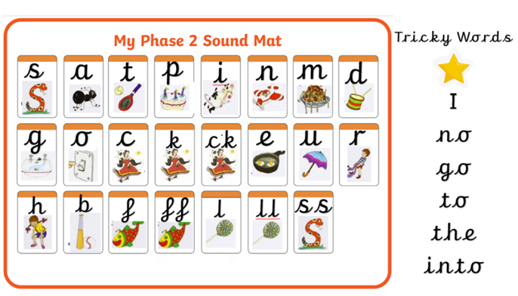

Slide 11

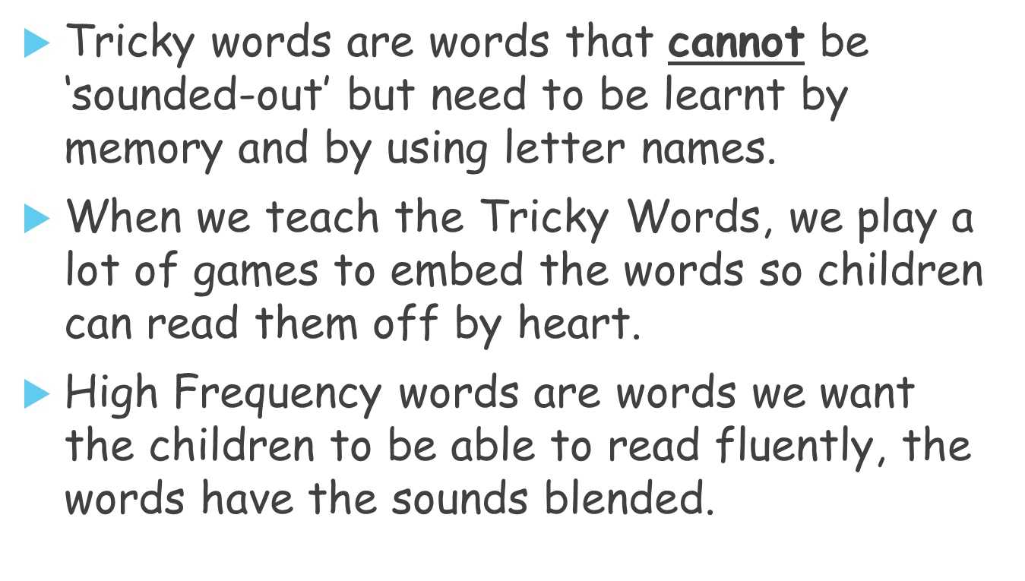

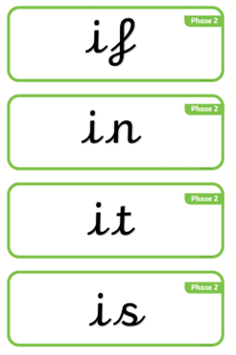
Tricky words / High-Frequency words

Slide 12
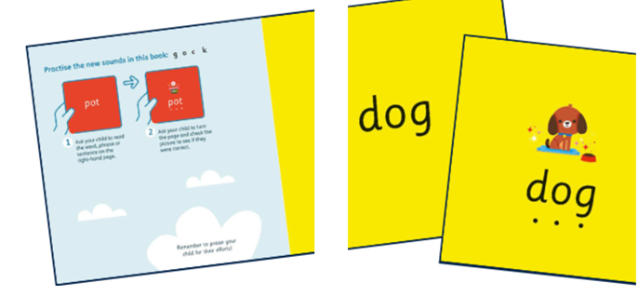
Phase 2 phonics
Little blending books - Focusing on blending cvc words

Slide 13
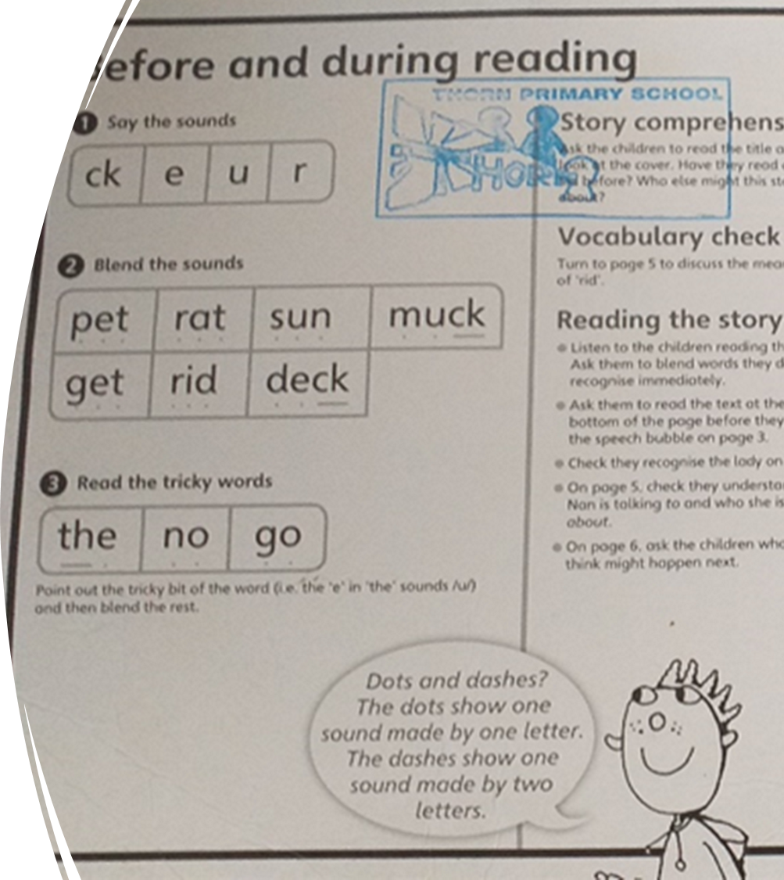
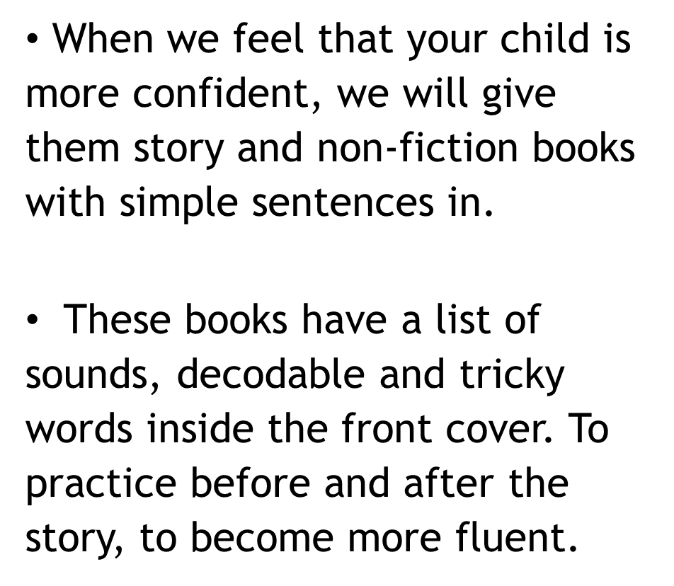
Books with sentences

Slide 14



Supporting Reading at Home for EYFS
Create a Library of books
Read Aloud and in different ways
Visit the Library
Repetition of reading to support memory
Point at the words / illustrations
Read little and often

Slide 15
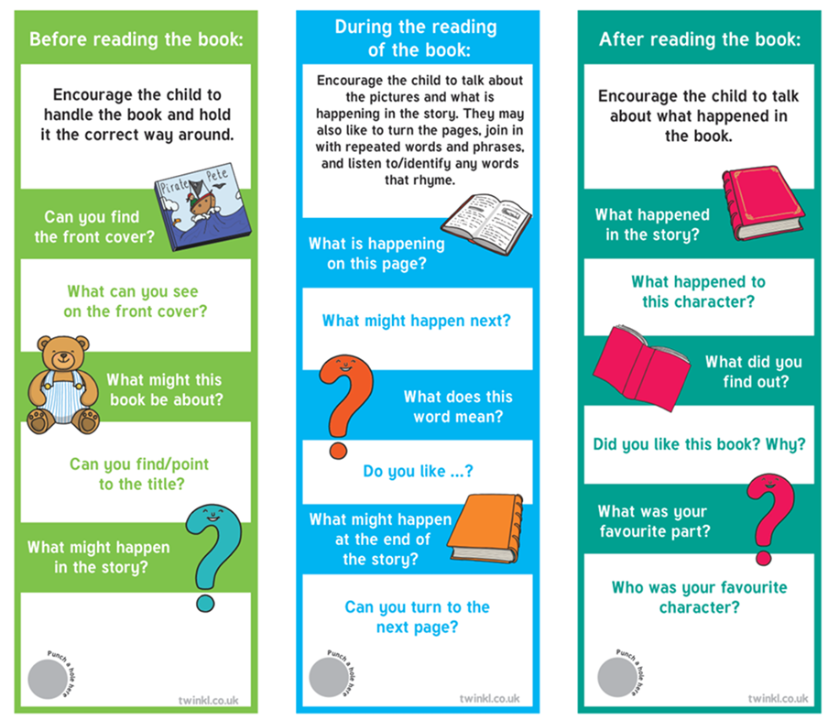



Reading Record
. Ask your child questions about the book, talk about
the illustrations to develop an understanding of the
story
. Create a positive reading environment with lots of praise
. Sign the reading record and make a comment

Slide 16
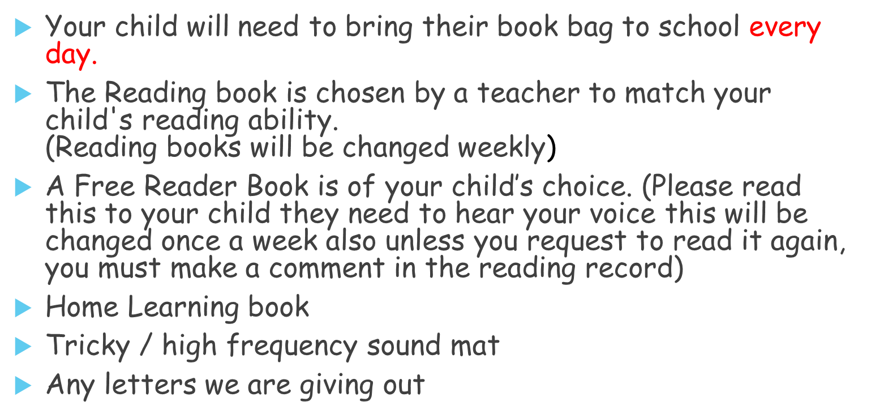
Book Bag...

